Slide 1
HUBZone Eligibility and Application Process

Slide 2
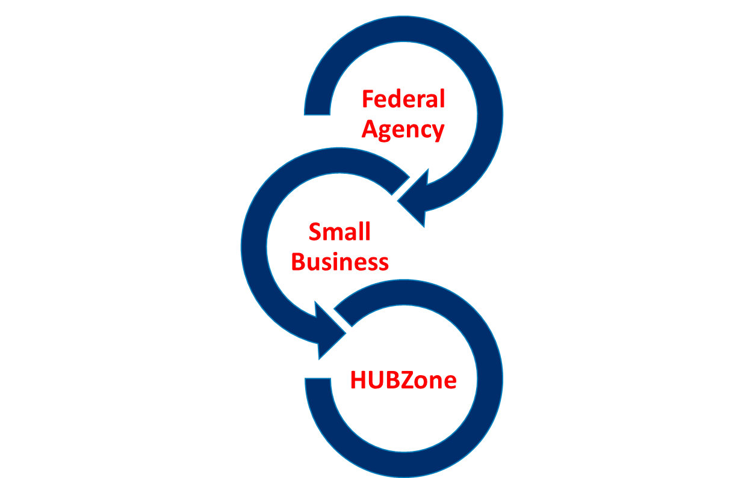
HUBZone Program Purpose
Established in 1997, launched in 1999
Fuels growth of small businesses in Historically Underutilized Business Zones (HUBZone) by providing certification for preferential access to federal government contracts.
  Federal agencies set aside contracts for HUBZone-certified small businesses
  Small businesses invest in and hire from qualified HUBZones
  Undercapitalized communities benefit from job opportunities and investment

Slide 3

Contracting Incentive
The HUBZone program plays an important role in driving 3 percent of all federal procurement opportunities to small businesses in undercapitalized communities.
12 percent Small Disadvantaged Business (SDB)
5 percent Women-Owned Small Business (WOSB)
3 percent Service-Disabled Veteran-Owned Business (SDVOSB)
3 percent Historically Underutilized Business Zone (HUBZone)

Slide 4
Eligibility

Slide 5
HUBZone Small Business Certification Eligibility
Firm must:
  Be small business based on SBA’s size standards;
    Based on primary North American Industry Classification System (NAICS) Code
  Be at least 51 percent owned and controlled by U.S. citizens, a Community Development Cooperation, an agricultural cooperative, a Native Hawaiian organization, or an Indian tribe;
  Have its principal office located in a HUBZone; and
  Have at least 35 percent of its employees live in a HUBZone.
Notes:
-SBA will allow firms who place employees on mandatory telework to maintain compliance with the principal office requirement, for certification and recertification purposes, if the firm met the principal office requirement prior to the telework measure being put into place.
-A firm will be eligible to compete for HUBZone set-aside awards while attempting to maintain compliance with the 35% HZ residency requirement, so long as at least 20% of its employees reside in a HUBZone.
-HUBZone firms that are performing on a HUBZone contract at the time of their recertification must have at least 20% of their employees residing in a HUBZone to recertify.
-HUBZone firms that are not performing on a HUBZone contract at the time of recertification must have at least 35% of their employees residing in a HUBZone to recertify.
-Added a provision related to the 35% residency HUBZone requirement that allows firms to be awarded for keeping on “legacy” employees even if those employees have moved out of a HUBZone.
-Once you certify, or annually recertify, you maintain that certification for an entire year, even if you dip below the 35% requirement (for employment of HUBZone residents)—OR, if your office moves temporarily out of a HUBZone—you won’t be kicked out of the program under this new rule.

Slide 6
HUBZONE MAP
Note - HubZone map changed on July 1, 2023.
Check new HubZone Map to determine whether your principal office and employees are located in a HubZone qualified area.
SBA uses information and data from multiple federal sources to determine HUBZone designated status. Such federal agencies include the U.S. Bureau of Labor Statistics, Department of Defense, Department of Housing and Urban Development, Bureau of Indian Affairs and the U.S. Census Bureau.
A redesignated area qualifies for a limited time as a HUBZone area. If or when a tract or county ceases to meet the qualifications for HUBZone status, due to changes in income, unemployment or poverty data, it becomes a redesignated area and qualifies as a HUBZone designated area for a period of three years.
When a tract or county is redesignated, its status in the HUBZone maps reflects the sunset date of the redesignation (date includes 3 years).
SBA will not update Qualified Census Tracts and Qualified Non-Metropolitan Counties on the map again until July 2028.

Slide 7
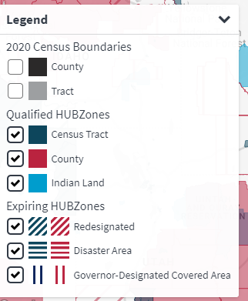
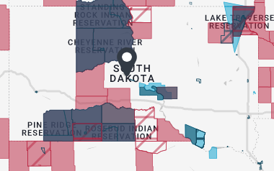
Sample of HubZone map – South Dakota

Slide 8
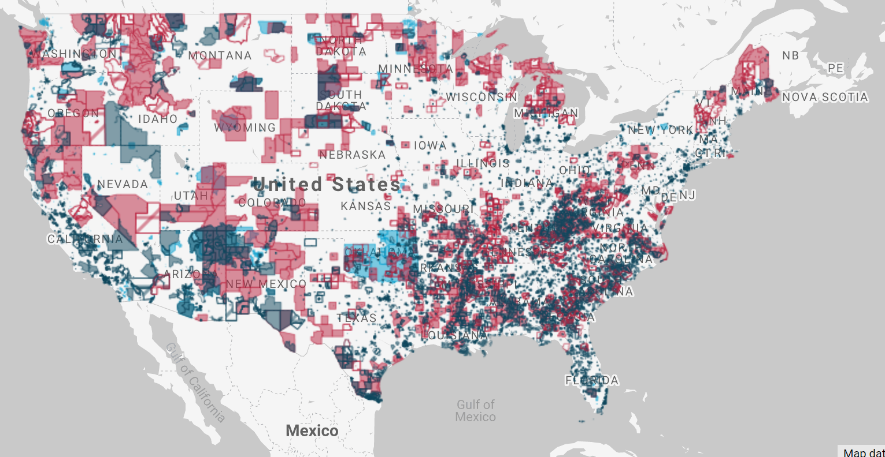
HUBZone Map
Find your business on the HUBZone Map

Slide 9
Application Process

Slide 10
Completing Your HUBZone Application
Ensure you are ready to do business with the federal government
  Figure out who in the federal government buys what you sell.
  Are you prepared to meet government expectations regarding performance bonds, lines of credit, accepting credit cards, security clearances, manufacturing requirements, wage rates, and limitations on subcontracting?
  Do you have a capabilities statement?
  Learn more about government contracting at www.sba.gov/federal-contracting.

Slide 11
Research
Before applying, does the government use the product or service that I provide?
www.beta.sam.gov
www.usaspending.gov
www.fpds.gov
Review the ‘wish list’ or forecast of agencies https://acquisition.gov/procurement-forecasts?searchTerms=forecast
Attend a procurement marketing/matchmaking event and visit with contracting officers

Slide 12
Accessing Your Business and Basic Requirements
Evaluate your small business to see if it has what it takes to win a government contract.
https://www.sba.gov/federal-contracting/contracting-guide/assess-your-business
Your small business must meet some basic requirements before you can compete for government contracts.
https://www.sba.gov/federal-contracting/contracting-guide/basic-requirements

Slide 13
Completing Your HUBZone Application
Use the spreadsheet eligibility calculator tool to ensure you meet
the program requirements
  Most firms are denied certification because they don’t meet the 35 percent HUBZone residency and/or principal office requirements or fail to provide sufficient verification.
  Use this calculator to check your eligibility before you apply.
  Save and submit this document with your application to expedite the review process.

Slide 14
Completing Your HUBZone Application
Gather ALL required supporting documents before you begin
Use the document checklist to be sure you have gathered EVERYTHING. If you are missing even one required document your submission will be withdrawn as incomplete and you will be required to resubmit. If you are unsure about a particular requirement, ask in advance (see resources below on last slide).
Use our HUBZone eligibility workbook calculator to present your information and verify eligibility. Save and upload it with your documents to expedite your review.
Check that a signature is included and the correct boxes are checked on the signature page.
Review and verify that your documents cover the electronic verification date (i.e. we can’t accept a payroll report or proof of residency that do not cover the required timeframes).
Ensure your documents—particularly those related to citizenship, HUBZone residency, and principal office—are legible and not expired. All leases must be signed by both parties AND contain dates.

Slide 15
Apply online through the HUBZone portal on SBA Connect
Apply online thru SBA Connect
  When starting your online application, it’s important to remember the following:
  You must be registered in the System Awards Management (SAM).
  Be sure to use the same Employer Identification Number (EIN) that you provided in SAM;
  using a different EIN may result in a rejection.
  Register for an SBA Connect account at connect.sba.gov and request access to the HUBZone
  portal. View the instructional video.
  Check the status of your application by logging into your account.

Slide 16
Completing Your HUBZone Application
Stay on top of email and check your spam folder to verify your
application IN TIME
Shortly after you submit in the HUBZone portal, you will receive a notice that you have 2 days to go back into the portal to verify your application. This becomes the electronic verification date by which your submission is analyzed.
Check your spam folder if you do not see the email right away; responding within the 2-day window is essential to ensuring your application isn’t rejected.

Slide 17
Completing Your HUBZone Application
Ensure your required documents are uploaded correctly
  Once your application is verified, you will receive another email from the SBA with instructions for uploading all required documents within 3 days. Check your spam folder for this as well.
  Have your documents ready to go so that when the email arrives, you are prepared to upload as directed. Be sure that the firm name and application number are on the documents.
  Refer to the document checklist to ensure you have completed all the steps.
  Be ready to respond quickly—within 5 days—to any requests from our team for additional documents.

Slide 18
Subcontracting
Subcontracting benefits to a prime contractor –
Money. Subcontractors cost less than employees and don’t come with a long-term financial commitment.
Time. Outsourcing work to subcontractors can free up time to focus on big-picture problems.
Flexibility. Many businesses choose subcontractors for the flexibility they offer without the commitment to long-term employment and businesses can easily increase and decrease capacity.
Expertise. Subcontractors add tools to your toolbox.
Simplicity. When you subcontract, you only have a fraction of the paperwork that comes with hiring a fulltime employee.
Gaining past performance . Working with partners (prime contractors) will allow you to gain past performance that you might not be able to gain elsewhere because they've already developed relationships. Building up your past performance is like a track record to use when you go after future work. You have a better chance at winning work when you have a credible record.
Subcontracting opportunities are posted on the following:
Subcontracting Network database (SBA’s sub-net)
General Services Administration’s Subcontracting Directory for Small Businesses
Department of Defense Subcontracting Opportunity Directory
SBA’s Directory of Federal Government Prime Contractors with a Subcontracting Plan

Slide 19
Consultant Fees
Firms ARE NOT REQUIRED to pay a consultant to apply and get approved. Consider cost/benefit of hiring a consultant when an existing employee could assist with the application process.
Contact local APEX Accelerator (formerly known as Procurement Technical Assistance Center PTAC) for assistance FREE OF CHARGE.

Slide 20
Assistance Available
APEX Accelerator provide local, in-person counseling and training services. APEX Accelerators provide no cost technical assistance to businesses that want to sell products and services to federal, state and/or local governments.
SAM Assistance - System for Award Management (SAM) registration is FREE, and your APEX Accelerator can help you with this and everything else you need to sell to agencies at little or no charge.
Local your local APEX Accelerator

Slide 21
Maintaining HubZone Certification
Recertify once a year – refer to recertification fact sheet
Complete a program examination at least every 3 years
Additional information on HubZone Program Improvements FAQs

Slide 22
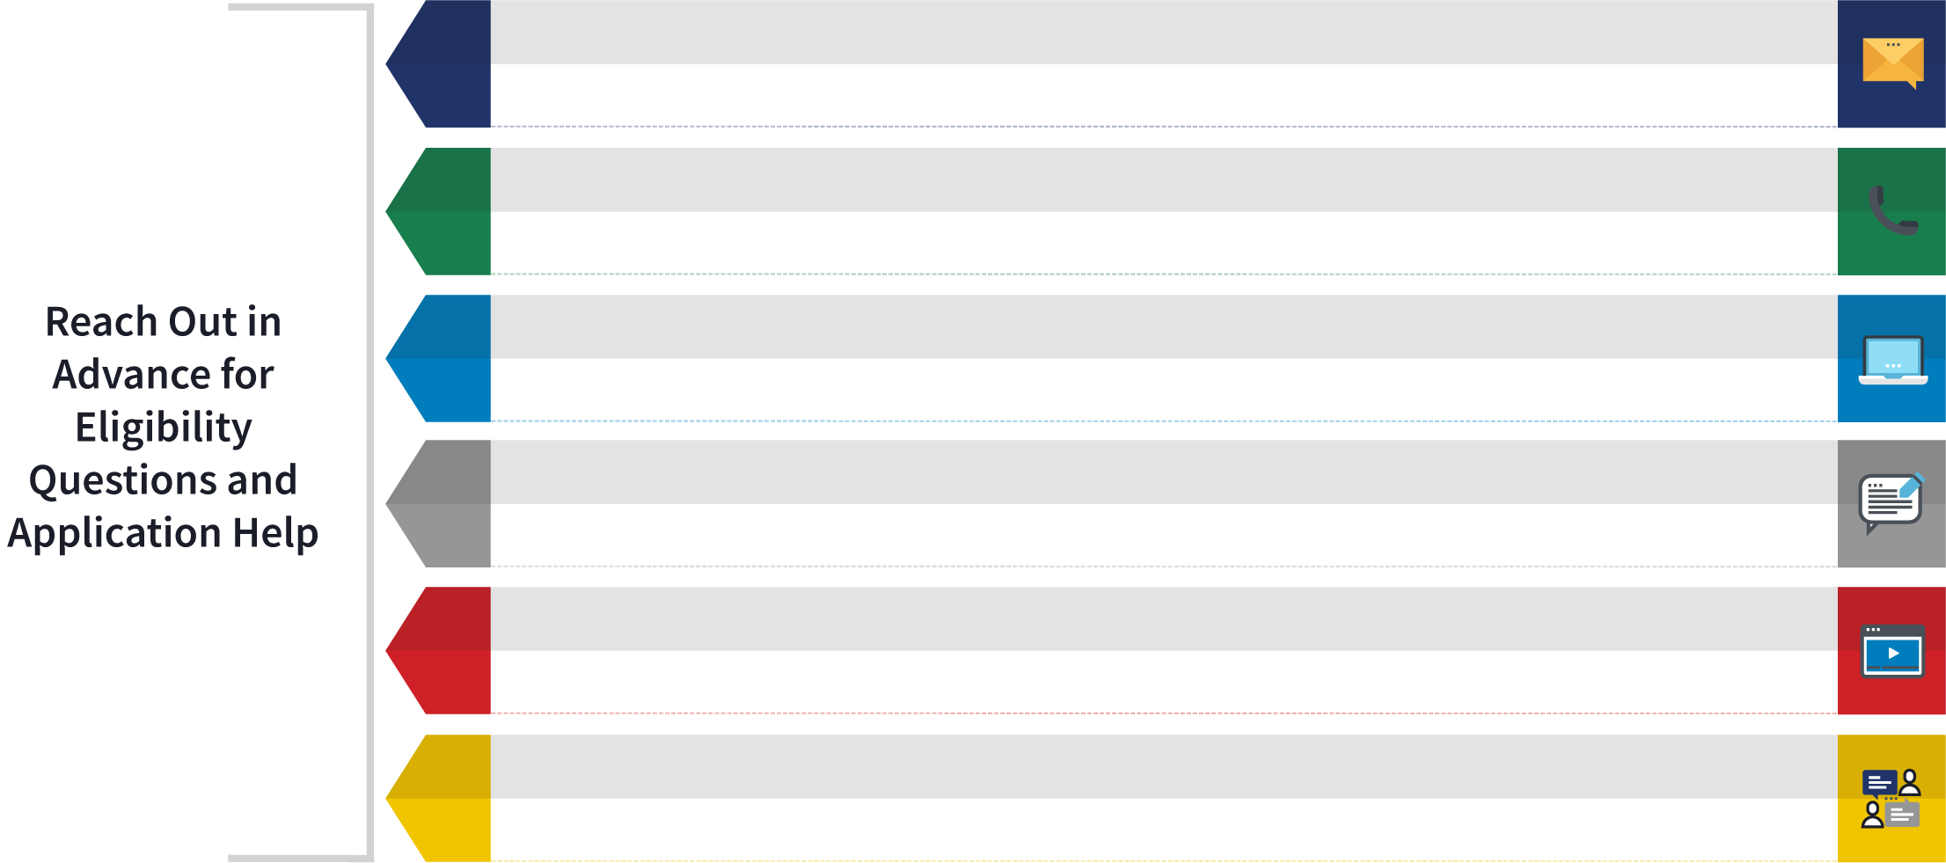
Ways You Can Get Help With Your Application Questions
EMAIL
HUBZone Help Desk at hubzone@sba.gov
CALL
Tuesday/Thursday | 2 p.m. ET | 1-208-391-5817 | ID: 278449067#
WEBSITE
FAQ
WEBINARS
SBA RESOURCES
.

Slide 23
HubZone Regulations
SBA’s Standard Operating Procedure (SOP) 80 06
Code of Federal Regulations (CFR) Part 126
Federal Acquisition Regulation (FAR) Part 19

Slide 24

Any Questions?

Slide 25
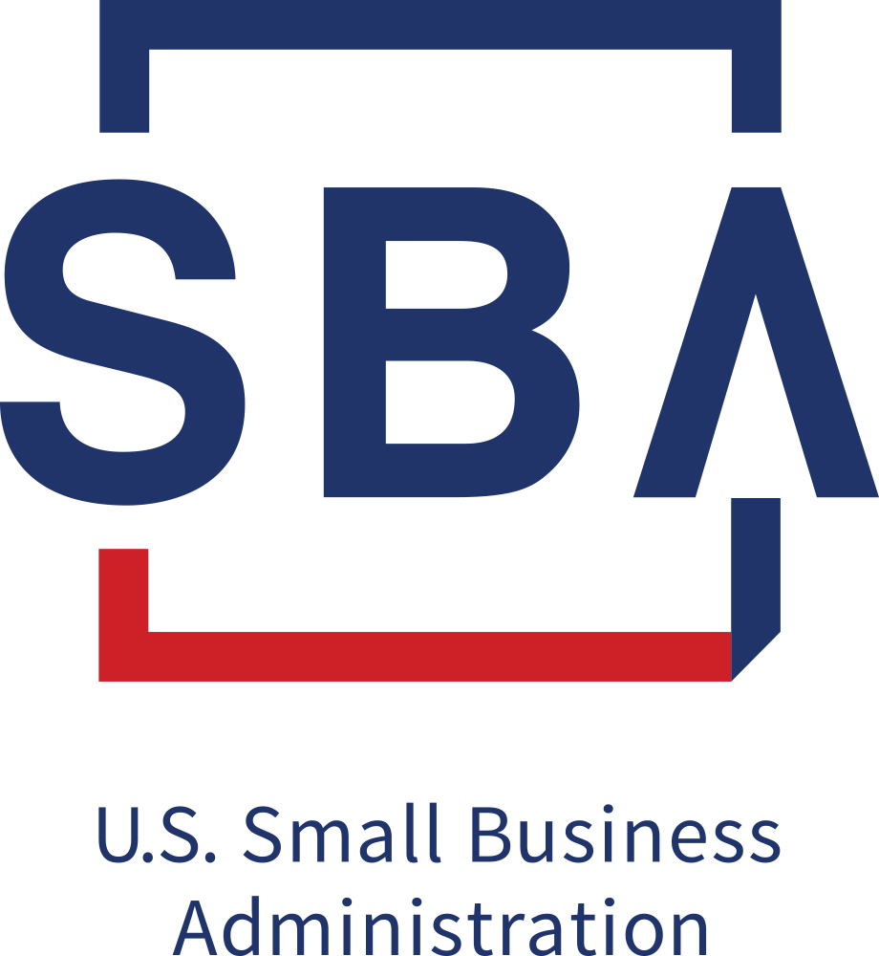
WOMEN-OWNED SMALL BUSINESS (WOSB) FEDERAL CONTRACTING PROGRAM

Slide 26
General Information
WOSB/EDWOSB Program helps provide a level playing field for women business owners - the government limits competition for certain contracts to businesses that participate in the women’s contracting program.
These contracts are for industries where women-owned small businesses (WOSB) are underrepresented. Some contracts are restricted further to economically disadvantaged women-owned small businesses (EDWOSB).
Joining the WOSB Federal Contracting Program makes a business eligible to compete for federal contracts set aside for the program.
Notes:
SBDC
Approx 1000 SBDC’s Nation-wide
Partially funded by SBA
Partially funded by States
Paid Staff
10 in Eastern PA
UPENN Wharton
Temple
Widener (not SBA funded)
Shippensburg (not SBA funded)
Kutstown
Bucknell
Lockhaven
LeHigh Valley
Scranton
Wilkes
SCORE
Approx 10500 volunteers nation-wide
Approx 400 chapters nation-wide
Volunteers
Mostly retired
Approx 10% still working
Approx 30% of their counseling is done on-line
13 in Eastern PA
Bucks County
Chester County
Chambersburg
Lancaster
LeHigh Valley
Monroe County
Montgomery County
Williamsport
Philadelphia
Pottstown
Reading
Wilkes-Barre
York
Womens Business Centers
Approx 120 nation-wide
Paid staff
3 in Eastern PA
WBDC in downtown Philadelphia
Empowerment Group in Philadelphia (Kensington)
Community First Fund in Lancaster
All Resource Partners Provide
Low cost training
Free consulting
Many SBDCs use graduate assistants
Examples
Help with Business Plan preparation
Marketing
Business set-up
Environmentals
HR
Accounting
Manufacturing
Distribution
Service
etc

Slide 27
Federal Prime Contracting
Small Business Goals FY 2023
Small Business - 23%
8(a)BD / Small Disadvantaged Business (SDB) - 12%
  This goal will increase 1% each year until 15% by 2025
HUBZone Small Business - 3%
Service-Disabled Veteran Owned Small Business - 3%
Woman Owned Small Business - 5%

Slide 28
Woman Owned Small Business (WOSB)
A small business based on SBA size standards
Based on primary North American Industry Classification System (NAICS) Code
No less than 51% unconditionally and directly owned and controlled by one or more women who are United States citizens.
Both long term decision making and day-to-day management and administration of the business.
Hold highest officer position.
Manage business on a full-time basis.
May not engage in outside employment that prevents her from devoting sufficient time and attention to daily affairs of the business.
You must offer services in one of the designated NAICS codes authorized for use under this program.

Slide 29
Economically Disadvantaged
Woman Owned Small Business (EDWOSB)
Meet all the requirements of the WOSB program AND
EDWOSB must be owned and controlled by one or more women, each with a personal net worth less than $850,000
Be owned and controlled by one or more women, each with $400,000 or less in adjusted gross income averaged over three years
Be owned and controlled by one or more women, each $6.5 million or less in personal assets

Slide 30
WOSB vs. EDWOSB
  Not all NAICS codes are available for use under the WOSB/EDWOSB Program.
To help provide a level playing field for women business owners, the government limits competition for certain contracts to businesses that participate in the Women-Owned Small Business (WOSB) Federal Contracting program.
These contracts are for specific industries where WOSBs are underrepresented. Some contracts are restricted further to economically disadvantaged women-owned small businesses (EDWOSBs)
  An EDWOSB is also considered a WOSB.
  Listing of WOSB & EDWOSB eligible NAICS codes
  https://www.sba.gov/document/support--qualifying-naics-women-owned-small-business-federal-contracting-program

Slide 31
Apply using Primary NAICS Code
If you plan to apply for the WOSB Federal Contracting Program, you must offer services in one of the designated NAICS codes authorized for use under the WOSB Federal Contracting Program.
If you do not see your NAICS code(s) designated for WOSB procurements, there might not be any set-aside opportunities for which you can compete at this time.

Slide 32
Application
  Firms can submit applications - https://wosb.certify.sba.gov/
  Checklist of documents required - https://wosb.certify.sba.gov/certify_wosb_checklist_final.pdf
  No term limit for this program - firms will at some point in the future need to attest to their continued eligibility.
  Firms may elect to use the services of third-party certifiers - SBA has approved four organizations.
  Is your business eligible?
  Helpful knowledge base category listing based on where an applicant is in the application process.
  Additional information – https://www.sba.gov/federal-contracting/contracting-assistance-programs/women-owned-small-business-federal-contracting-program

Slide 33
WOSB/EDWOSB regulations
SBA’s Standard Operating Procedure (SOP) 60 02
Code of Federal Regulations (CFR) Part 127
Federal Acquisition Regulation (FAR) Part 19

Slide 34
MPA Program Qualifications
To qualify as a protégé, your business must:
Be a small business with industry experience using SBA's table of small business size standards.
Be organized for profit or as an agricultural cooperative.
Have a proposed mentor prior to applying for the program.
To qualify as a mentor, your business must:
Be organized for profit
Be able to carry out its responsibilities to assist the protégé
Possess good character
Not appear on the federal list of debarred or suspended contractors
Be able to impart value to a protégé firm due to lessons learned and practical experience gained or through its knowledge of general business operations and government contracting.
Application to SBA -
Apply for SBA’s Mentor Protégé Program (MPP).
SBA must determine that the mentor-provided assistance will promote real developmental gains for the protégé, not just act as a vehicle to receive federal small business set-asides.
An applicant protégé and its prospective mentor may not be affiliated at the time of application.

Slide 35






Mentor Protégé Program
SUPPORT FROM MENTORS
MANAGEMENT & TECHNICAL ASSISTANCE
FINANCIAL ASSISTANCE
CONTRACTING ASSISTANCE
INTERNATIONAL TRADE EDUCATION
BUSINESS DEVELOPMENT ASSISTANCE
ADMINISTRATIVE ASSISTANCE

Slide 36
PREPARE AHEAD
2
1
SELECT YOUR MENTOR
2
REGISTER IN SAM & COMPLETE SBA’s ONLINE TUTORIAL (BOTH COMPANIES)
3
APPLY THROUGH CERTIFY
4
ALLOW 105+ DAYS
REMAIN RESPONSIVE
15 DAYS FOR SCREENING
90 DAYS FOR PROCESSING
SUBMIT A CLEAN CASE
CONTACT US FOR RECONSIDERATIONS
5
CHECK YOUR INBOX & SPAM
RESPOND QUICKLY
RESPOND QUICKLY
CONTACT US FOR RECONSIDERATIONS

Slide 37
PROTEGES MUST:
Submit annual reports
MENTORS MUST:
Demonstrate material or developmental benefits
Provide meaningful assistance, as described in agreement
Submit quarterly financial reports and Certificate of Compliance for JV’s

Slide 38
JOINT VENTURE BASICS
Considered ‘limited purpose entities’
MPA approval required prior to JV bid on award
SBA only reviews and approves JVs when the JV has an 8(a) sole source offer.
MPA JVs are granted exclusions from affiliation
  Note - MPAs are not required to have a JV in place (would be necessary only if the JV partner is large).
MPA JV contracts awards are limited to 2 years
Procuring activities must consider work done individually by each partner to the joint venture as well as any work done by the joint venture itself.
Protégé firms must perform at least 40%, Mentor firms may perform up to 60%
NEW – 8(a)/WOSB/HubZone/SDVOSB cannot be JV partner for more than 1 JV per contract

Slide 39
Code of federal regulations references
Small Business Mentor-Protégé Program
13 CFR 125.9
Service-Disabled Veteran
13 CFR 125.15(b)
8(a) and SDB Regulations
13 CFR 124.5
SBA Size Regulations
13 CFR 121
Small Disadvantaged Business
13 CFR 124.1002(f)
HUBZone Program
13 CFR 126.6
WOSB Program
13 CFR 127
SBA Prime Contracting
13 CFR 125.2
SBA Subcontracting
13 CFR 125.3
Non-manufacturer rule
13 CFR 121.406(b)
Limitations on subcontracting
13 CFR 125.6

Slide 40
Any Questions?

