Slide 1
PBS New England Region Presents:
Virtual
Customer
Forum
Tuesday, August 10, 2021
1:00-3:00PM, EST
Richard C. Lee United States Courthouse, New Haven, CT
Notes:
Instructions: Cover Page. This is the cover template. Title placeholders. While not necessary, dual titles can be helpful if you’d like to include a team name, such as (Line 1) “Section 508 Team” (Line 2) “January Metrics Report.” It can also be used to split up a longer title, with the larger part highlighting key words. (Line 1) “How to successfully” (Line 2) “check site accessibility.” Sample can be seen on slide 2. Delete or ignore the blue title line if you do not need multiple lines. Use the subtitle placeholder at the bottom of the screen to note the speaker and/or date of the presentation. TO PRINT: Use black & white mode. These slides are designed for on-screen viewing, and the dark backgrounds use a lot of toner if printed.

Slide 2
Agenda
COVID-19 & Return to Facilities
The Future of Workplace
Short Break
Strategies for Real Property Utilization
Federal Acquisition Service Offerings
Climate Resilience
Closing Remarks
Notes:
Instructions: Agenda Option 3. This is an option for how you can structure an agenda. This layout might work best when you need to also highlight speaker names or start times along the right side. Add rows of text if you need more sections, or remove excess lines and evenly space out the remaining rows.

Slide 3
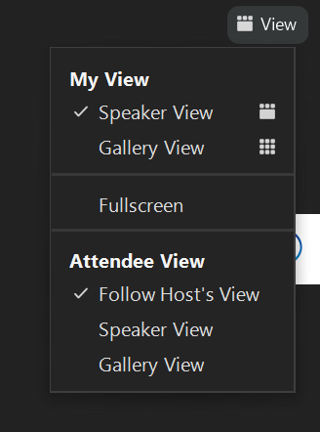
Housekeeping
Zoom for Government:
Auto-mute
Q&A pod - Questions for Presenters
Chat pod - Administrative & Technical Questions
View settings
Closed Captioning
Presentation & Survey will be shared
WelWelcome
WE
Notes:
Housekeeping reminders - insert snippets of Q&A Pod; reminder that audience is auto-muted - closed captioning feature, etc.

Slide 4
Hosted by:
Vicki Kwiatek
Regional Service Delivery Officer
Branch Chief, Client Engagement Branch
Portfolio Management &
Client Engagement Division
vicki.kwiatek@gsa.gov
Kelly Morrison
Business Systems Specialist
Portfolio Management &
Client Engagement Division
kelly.morrison@gsa.gov

Slide 5
Opening Remarks:
Glenn Rotondo
Acting Regional Administrator
Public Buildings Service (PBS) Regional Commissioner

Slide 6
Opening Remarks:
Joe Nickerson
Federal Acquisition Service (FAS)
Regional Commissioner

Slide 7
COVID-19 &
Return to Facilities
What to Expect
Notes:
Instructions: Cover Page. This is the cover template. Title placeholders. While not necessary, dual titles can be helpful if you’d like to include a team name, such as (Line 1) “Section 508 Team” (Line 2) “January Metrics Report.” It can also be used to split up a longer title, with the larger part highlighting key words. (Line 1) “How to successfully” (Line 2) “check site accessibility.” Sample can be seen on slide 2. Delete or ignore the blue title line if you do not need multiple lines. Use the subtitle placeholder at the bottom of the screen to note the speaker and/or date of the presentation. TO PRINT: Use black & white mode. These slides are designed for on-screen viewing, and the dark backgrounds use a lot of toner if printed.

Slide 8
Presenters:
Michael Franzese
Director, Service Center Division
GSA-Public Buildings Service
michael.franzese@gsa.gov
Christopher Giunta
Chief, Building Operations
& Tenant Services Branch
Facilities Management Division
christopher.giunta@gsa.gov
Shayne Doherty
Outleasing Manager, LCO
Real Estate Acquisition Division
shayne.doherty@gsa.gov
Danielle Piantedosi
Senior Leasing Specialist, LCO
Real Estate Acquisition Division
danielle.piantedosi@gsa.gov
Notes:
Instructions: Divider. Use dividers to visually cue your audience that you’re changing sections or topics within a presentation.

Slide 9
COVID-19 UPDATE
COMMUNICATIONS
R1 NUMBERS
FACILITIES MANAGEMENT
HEALTH & SAFETY
Notes:
Michael Franzese
(Michael will be presenting most of the materials and other presenters will be identified)

Slide 10
RETURN TO FACILITIES
BROAD VIEW
PHYSICAL ACCESS CONTROL SYSTEM - PACS
PUBLIC BUILDINGS SERVICE TEAM
Notes:
Michael Franzese

Slide 11
COMMUNICATIONS
COVID 19 & RETURN TO FACILITIES
GSA is following CDC guidance and recommendations and communicating with Agency POC’s and Court/Facility Security Committees.
Property Managers continue to provide information when there is a COVID-19 reported incident in a facility.
Property Managers have distributed a document at the building level with specific information on action taken to help reduce the spread of COVID-19.
Notes:
Michael Franzese
New guidance 7/28/21 - placeholder - included in communications on this slide and on the Return to Facilities slide under Preparation:
To maximize protection from the Delta variant and prevent possibly spreading it to others, wear a mask indoors in public if you are in an area of substantial or high transmission

Slide 12
COMMUNICATIONS
Effective Immediately - Guidance from July 29 2021
Facility Managers and Lease Administration Managers (LAM) will check the CDC COVID Data Tracker and the COVID-19 Integrated County View daily to determine transmission status in the area where the facility they manage is located.
In an area of high or substantial transmission, or if the local area requires masks, the Facility Security Committee (FSC) will be engaged and signs posted that masks are required for all persons wishing to access and while in the facility, including entry signage that will be posted at the building exterior entrances. In a Primary Courthouse we will work with the Court Security Committee POC to determine the entrance protocol and post signs accordingly.
Notes:
Michael Franzese
signage/mask samples later in presentation

Slide 13
COVID-19: R1 Numbers
March 2020 - Current
11,988 Reported Incidents Nationally
524 Reported Incidents in New England:
365 Federally-owned
159 Leased
2nd Lowest Number of Reported Incidents
93% Resolved Within 0-7 Days
Notes:
Michael Franzese
Tracked Regionally March 2020 - September 2020, then nationally using the Executive Dashboard
Note: tracking for # of days to resolution began 10/1/20
-”Incidents” - report of someone physically present in the workplace who tested positive for COVID-19
-”resolved” - Property Manager has the custodial crew clean & disinfect the area where the incident was reported.

Slide 14
COVID 19: FACILITIES MANAGEMENT
HVAC & WATER/PLUMBING
Filter fit and MERV (Filter Efficiency) ratings have been verified per system design and manufacturer specifications.
Building HVAC systems have longer run times, outside air is maximized based on equipment and environmental conditions.
Created drinking water guidance based on EPA recommendations; and water lines are randomly tested, flushed, and adjusted to maintain water quality.
Notes:
Michael Franzese
Outside air maximized - 2 hrs before and 2 hrs after
Goal is for balanced temperature; understand not ideal for everyone comfort-wise

Slide 15
COVID-19: HEALTH & SAFETY
FEDERAL LOCATIONS
CLEANING
HVAC
NEW PROJECTS
Contracts modified for required daily disinfecting of high contact surfaces in common and high traffic areas through September 30, 2021.
Effective October 1, 2021, routine daily cleaning of high contact surfaces will continue without disinfecting.
CDC HVAC recommendations incorporated based on existing equipment and current configuration.
All buildings have been fully operational throughout the pandemic.
Specific building actions have been shared with points of contacts.
CARES Act HVAC Upgrades
National Outdoor Air Ventilation study (NOVA)
Notes:
Michael Franzese

Slide 16
COVID 19: HEALTH & SAFETY
CLEANING SERVICES: Modified (current) and Future
Buildings had full cleaning services and were fully staffed throughout the pandemic.
GSA will continue to clean and disinfect any space following a COVID-19 incident within 72 hours of when the affected person was last in the space. ​
Additional operating costs in FY22 will not be implemented as initially planned. COVID related costs will be monitored through FY22
Notes:
Michael Franzese

Slide 17
RETURN TO FACILITIES - Broad View
PLANNING
Customer Return-to-Work Tracker to help with planning.
Collaboration with agencies to identify changes in requirements and utilization.
Evaluate potential for lease to federal backfill on a case-by-case basis.
PREPARATION
Hand sanitizer stations in common areas.
CDC guidelines and recommendations will continue to be followed:
Cleaning, HVAC, Water & Plumbing
Masks and Safe Distancing
Signage Locations & Samples
Notes:
Michael Franzese

Slide 18
SIGNAGE SAMPLES
Where Transmission Rates are Low - Guidance as of 7-29-21

Slide 19
SIGNAGE SAMPLES
Where Transmission Rates are Substantial/High - Guidance as of 7-29-21

Slide 20
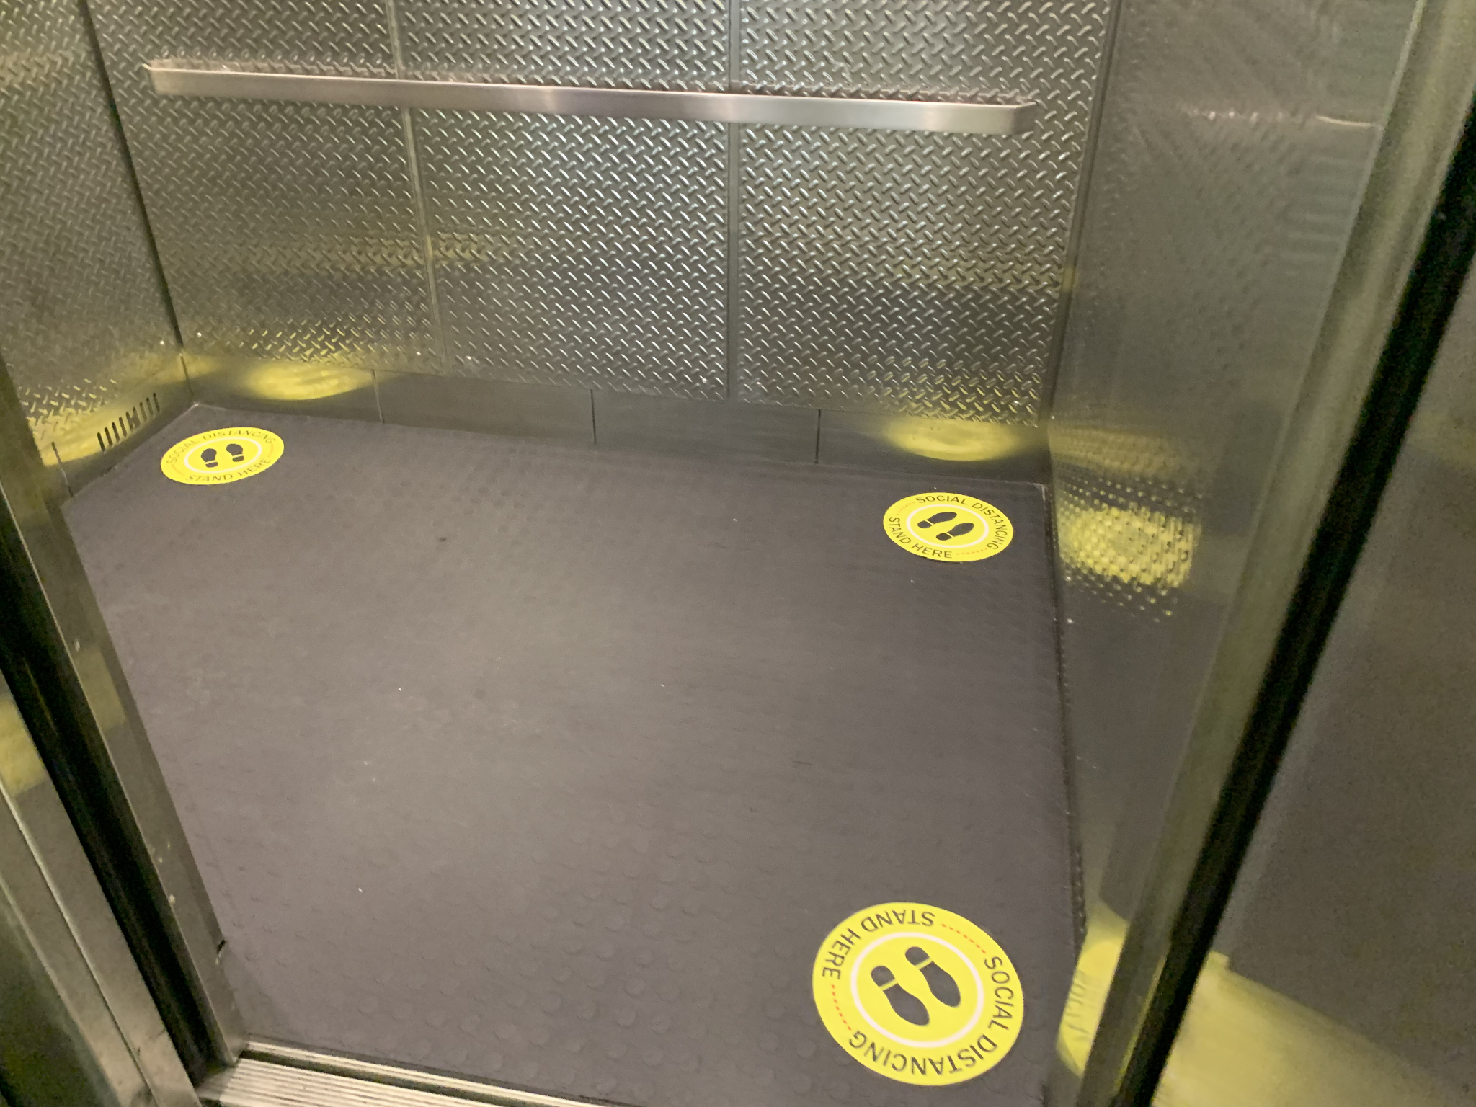
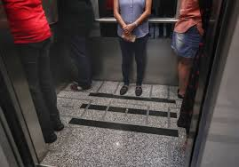
SAFE DISTANCING
NEW NORMAL

Slide 21
Leasing Update Presented By:
Danielle Piantedosi
Senior Leasing Specialist,
Lease Contracting Officer
Real Estate Acquisition Division
danielle.piantedosi@gsa.gov
Shayne Doherty
Outleasing Manager,
Lease Contracting Officer
Real Estate Acquisition Division
shayne.doherty@gsa.gov
Notes:
Instructions: Divider. Use dividers to visually cue your audience that you’re changing sections or topics within a presentation.

Slide 22
COVID-19: HEALTH & SAFETY
COMMERCIAL LEASES
CLEANING
HVAC
CARES ACT
Unilateral Lease Amendments (ULA’s) issued requiring daily cleaning and disinfecting through October 1, 2021.
Disinfectants are EPA- registered, identified as effective against Novel Coronavirus SARS-CoV-2.
Lessor’s to continue to follow current industry practices concerning building ventilation.
HVAC system capacity determines rating of filter.
Highest rated MERV (Minimum Efficiency Reporting Value)-13 filters recommended for all leases that can meet capacity requirements.
Funding under Cares Act expires as of September 30, 2021
Agencies have budgeted for FY22 cleaning, however GSA will not be billing for the additional cleaning at this time.
Determination on agencies reprogramming money for mission critical use, GSA Counsel reviewing.
Notes:
Danielle Piantedosi

Slide 23
RETURN TO FACILITIES
COMMERCIAL-LEASES: Notifications to Customers, Lessors, & LCO/LS
National Update
Cleaning Efficacy
Letter to Lessor
On July 12, 2021, GSA Customers at the National Director level and key regional staff were advised by GSA that we will continue to follow CDC guidelines that no longer require disinfecting cleaning of high touch surfaces through September 30, 2021.
Headquarters level directors have been informed.
Effective October 1, 2021; Lessors can perform the cleaning in accordance with Lease to Pre-Covid standards.
Effective September 30, 2021; Operating rental rates to return to pre-covid rates in accordance with the change in cleaning standards.
On July 13, 2021, Lessors were notified of the CDC guideline implementation.
With approximately 375 regional leases, 150 leases are eligible for cleaning and ULA’s have been issued.
Over 8,000 lessors received the following letter electronically.
Notes:
Danielle Piantedosi or Shayne Doherty for Michael Strobel - Leasing
Notifications generally included in the communications slide (#6); keep for Leasing-specific?
Lessor notification Link is to a Google Drive doc (pdf); access issue for clients as resource. Pull up during presentation? Remove reference?
If located in gsa.gov; convert and put on resource page?
https://mail.google.com/mail/u/0/#inbox/WhctKKWxTCSShGJrnDpTzDKCmQTHhjwJgBCQrXLzmdPBkbrHCNLTflgqHhLRDTkpCnCZMVQ?projector=1&messagePartId=0.1

Slide 24
RETURN TO FACILITIES
LETTER TO THE LESSORS
This letter is provided for your reference regarding [Lease_No] for the [Agency_Name] located at [Building_Address], [Bldg_City], [Bldg_State] [Bldg_Zip], and is to reinforce your obligation to maintain janitorial services during the COVID-19 pandemic. It is not a change to your Lease, or any subsequent lease amendments, with the U.S. General Services Administration (GSA).
The health and safety of tenants and visitors in buildings where GSA leases space is GSA’s highest priority. The Centers for Disease Control and Prevention (CDC) recommends daily cleaning of high-touch surfaces to prevent the spread of COVID-19. To protect tenants and visitors in the building, GSA trusts that, as lessor for the aforementioned leased location, you are complying with the janitorial specification requirements to clean the space as set forth in your Lease.
Your Lease with GSA includes cleaning specifications that require the lessor to maintain the premises and all areas of the property to which the Government has routine access in a clean condition for the term of the Lease. Such cleaning of the space should include high-touch surfaces, including, but not limited to, door knobs, light switches, handles, handrails, elevator buttons, toilets, faucets, and sinks, to which the Government has access, using cleaning products in accordance with current CDC guidelines.
Please refer to the following link for more information about CDC’s cleaning guidance: Cleaning and Disinfecting Your Facility. As CDC’s guidance for cleaning may change from time to time, you should refer to this page frequently for reference.
Notes:
Danielle Piantedosi

Slide 25
RETURN TO FACILITIES
LETTER TO THE LESSORS - (cont’d)
Please note that this letter is in regards to performance of the standard janitorial service requirements under the Lease, regardless of any additional requirements for routine disinfection of the space. To the extent the Lease contains specific COVID-19 pandemic requirements for routine disinfection of the space, you should continue to provide disinfection services as outlined in the Lease or lease amendment, as applicable, unless you receive further direction from GSA.
If GSA issued a lease amendment requiring routine disinfection services, you should continue to provide disinfection services through September 30, 2021.
If you have a recently awarded Lease with GSA that includes routine disinfection services as a permanent specification, you should continue to provide disinfection services, unless GSA provides notice to discontinue these services.
If you have any questions, please contact GSA, Public Buildings Service, Office of Leasing, at gsa-leasing-covidresponse@gsa.gov. Thank you for your cooperation in supporting GSA’s response to the COVID-19 pandemic.
Notes:
Danielle Piantedosi or Shayne Doherty for Michael Strobel - Leasing

Slide 26
Presented By:
Return to Facilities: PACs Update
Christopher Giunta
Branch Chief, Building Operations
& Tenant Services
Facilities Management Division
christopher.giunta@gsa.gov
Notes:
Instructions: Divider. Use dividers to visually cue your audience that you’re changing sections or topics within a presentation.

Slide 27
RETURN TO FACILITIES
PHYSICAL ACCESS CONTROL SYSTEM - PACS
SITUATION
LOCATIONS
TENANT ACTIONS
GSA is changing PACs within the next seven months.
Project is underway; two buildings complete.
All tenants are required to re-enroll their PIV cards to maintain access.
New employee enrollment process is unchanged.
O’Neill FB
JFK FB
McCormack POCH
Williams USCG
Murphy FB (NARA)
Gignoux CH
MC Smith FB
Norris Cotton FB
St. Albans FB
Ribicoff FB&CH
Cotter FB
Lee CH
Giaimo FB
Re-enroll your PIV card at earliest convenience.
Locations of enrollment station vary from building-to-building; contact the property manager for hours and instructions.
Notes:
Chris Giunta

Slide 28
R1 PBS Contacts
Regional Senior Management
Glenn Rotondo - Acting Regional Administrator,Regional Commissioner
Matthew Bailey - Deputy Regional Commissioner
Service Centers Division
Michael Franzese - Director
Eric Keuraleinan - Branch Chief-Boston
Tim Shobbrook - Branch Chief-North
Kevin Whitman - Branch Chief-South
Leasing Division
Steven Smith - Deputy Director & Acting Director
Michael Strobel - Lease Acquisition Officer
https://www.gsa.gov/staff-directory
Notes:
Michael Franzese - if keep, general reference to the the team?
Does Glenn want this slide? Any additions - titles correct?

Slide 29
R1 PBS Contacts - continued
Facilities Management & Services Programs Division
Walter Perez - Director
Karen Curran - Branch Chief
Chris Giunta - Branch Chief
Portfolio Management & Client Engagement Division
Scott Fuller - Branch Chief, Portfolio Management
Vicki Kwiatek - Regional Service Delivery Officer & Branch Chief, Client Engagement
https://www.gsa.gov/staff-directory
Notes:
Michael Franzese - if keep, general reference to the the team?
Does Glenn want this slide? Any additions - titles correct?

Slide 30
R1 PUBLIC BUILDING SERVICES
Resources
GSA's Response to COVID-19 (Coronavirus)
Centers for Disease Control (CDC):
Cleaning and Disinfecting
Guidance for Business and Employers (provided to Lessors)
Safer Federal Workforce: White House COVID Response Team:
GSA, OPM, CDC, VA, FEMA, FPS, OMB, & USSS
Notes:
Michael Franzese
Slide may be moved to comprehensive list
If kept in PBS section, can refer to it

Slide 31
Return to Facilities
Q&A
Utilize the Q&A pod to pose
questions to the panelists.

Slide 32
Presented By:
Rhisa Prince
Account Manager
Portfolio Management &
Client Engagement Division
rhisa.prince@gsa.gov
Future of Workplace
Notes:
Instructions: Cover Page. This is the cover template. Title placeholders. While not necessary, dual titles can be helpful if you’d like to include a team name, such as (Line 1) “Section 508 Team” (Line 2) “January Metrics Report.” It can also be used to split up a longer title, with the larger part highlighting key words. (Line 1) “How to successfully” (Line 2) “check site accessibility.” Sample can be seen on slide 2. Delete or ignore the blue title line if you do not need multiple lines. Use the subtitle placeholder at the bottom of the screen to note the speaker and/or date of the presentation. TO PRINT: Use black & white mode. These slides are designed for on-screen viewing, and the dark backgrounds use a lot of toner if printed.

Slide 33
Future of Workplace
1
Future of Federal Work
2
Workplace Offerings & Resources
3
GSA R1 Model Workplace Project
Notes:
Instructions: Agenda Option 1C. This is a similar option for how you can structure an agenda, but with even less slots. Add or remove rows in SLIDE > EDIT MASTER. Use the Intake Form to request support.

Slide 34
Future of Federal Work
Future of Federal Work - Workplace 2030
A once-in-a-generation opportunity
A vision co-created by over 100 experts from 18 agencies
Notes:
Instructions: Blank slide (Dark Background). Use this when none of the existing layouts work for you, and you need to design your own slide. If you have a vision for your slide design, feel free to contact the ME Content Management Team for layout support.

Slide 35
Future of Federal Work
Workplace 2030 Guiding Principles
Work can be done anywhere, at any time
Distributed work is trusted work
The office is necessary, but its purpose is shifting
Agencies are willing to share space
Talent recruitment and retention can benefit from distributed work
Distributed work is an employee benefit
There are challenges to overcome
Work can be done anywhere, asynchronously
Real Estate will be used to maintain and enhance human connection
Technology will be the force that brings our work together
Notes:
Instructions: Blank slide (Dark Background). Use this when none of the existing layouts work for you, and you need to design your own slide. If you have a vision for your slide design, feel free to contact the ME Content Management Team for layout support.

Slide 36
Future of Federal Work
Workplace 2030 Implementation Insights
Capturing this opportunity will take a new approach
Agencies will need additional support from GSA to bolster their efforts and increase the chance of success
Work today requires an interrelated mix of services
Agencies have different priorities and will need a different mix of services
Notes:
These services must adapt and expand to support the evolution of work over time

Slide 37
Future of Federal Work
Workplace 2030 - GSA Emerging Services
Five Services Ranked as having the Highest Impact and Urgency:
Home office in a box
Workplace & Technology Showcase
GSA Flex Hub
Work Support App
Space Monitor / Feedback Loop
Notes:
GSA has begun to develop an expanded suite of services

Slide 38
Workplace Offerings & Resources
Available Now
Return to Workplace Strategy Book / IDIQ Contract
Workplace Engagement / IDIQ Contract
Workplace Investment and Feasibility Modeling (WIFM)
Notes:
Instructions: Lists/set of points on a single slide, numbered. This is for when you want to highlight a list or set of items without visuals. Be brief and to the point; don’t overwhelm your audience with text. If you need additional boxes in your list, work with the ME Content Management Team. Use the Intake Form to request support.

Slide 39
GSA Safer Workplace Strategy Book
Summarizes information across government and industry
Guidance and considerations
Not requirement or directives
Strategy Book is divided into 5 sections:
Business Planning - how to approach timing, capacity planning
Workspace Behavior & Operations - protocols, cleaning and disinfections
Facilities Readiness - physical distances, circulation, floor plan examples
Signage - downloadable signage package
Additional Resources - GSA contacts and external links
Download from GSA’s Safter Federal Workplace Site
Notes:
Instructions: Blank slide (Dark Background). Use this when none of the existing layouts work for you, and you need to design your own slide. If you have a vision for your slide design, feel free to contact the ME Content Management Team for layout support.

Slide 40
Return to Workplace Planning Services IDIQ
GSA has identified 10 services for Return to Workplace Planning
Purchased via RWA on a la carte basis
Priced based on location headcount and complexity
Workplace Demand
Workplace Supply
Occupancy Stacking
AutoCAD
Furniture Test Fits
GSA’s Center for Workplace Strategy also has a national contract available to assist with any workplace planning, design or other need.
Customized Signage and Wayfinding Graphics
Validate Integrated Approach & Identify Gaps
Change Management Communications Planning
Behavioral Protocols
Day 2 and Beyond
Notes:
Instructions: Blank slide (Dark Background). Use this when none of the existing layouts work for you, and you need to design your own slide. If you have a vision for your slide design, feel free to contact the ME Content Management Team for layout support.

Slide 41
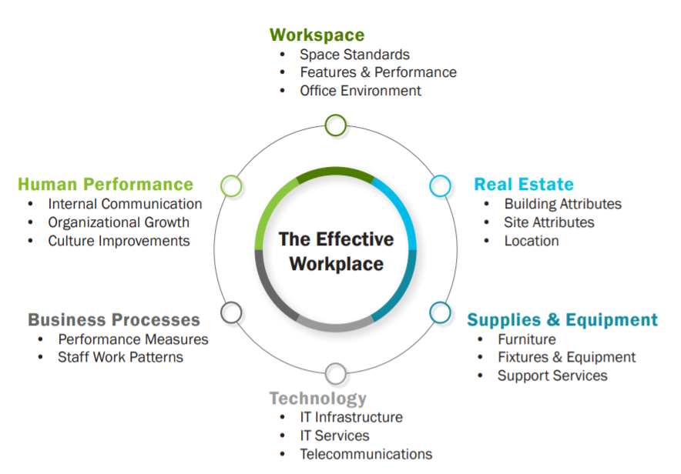
Workplace Engagement / IDIQ Contract
Workplace Strategy Development / Requirements Development
Use organizational business goals to determine workplace changes.
Ensure the new workplace recognizes and supports current and future employee work practices.
Consider Multiple perspectives when developing workplace strategies, especially from leaders and employees.
Consider multiple workplace strategies for the new workplace. Don’t focus on just one approach.
Notes:
Engages your entire organization using a variety of diagnostic research tools to create tailored workplace strategies
Begins at strategic requirements and informs the phases of requirements development, project initiation and project planning
IDIQ contract can be utilized to further develop technical requirements and change management support

Slide 42
Workplace Engagement / IDIQ Contract
Diagnostic Tools
Visioning Session
Direction of workplace change
Vision of the end-state
Alignment along leaders
1:1 Leader Interviews
Future business direction
Gaps that inhibit change
Modes of workplace & processes
Top-Down
Pre-Occupancy Survey
Current space performance
Mobility and work practices
Telework/desk sharing potential
Employee Focus Groups
Explore survey results
Inform change management strategies
Identify opportunities / obstacles
Bottom-Up
Current Space Analysis
Future business direction
Gaps that inhibit change
Modes of workplace & processes
Time/Space Utilization Analysis
Measure utilization and occupancy levels
Validate and compare data
Identify opportunities to increase space efficiency
Notes:
Instructions: Blank slide (Dark Background). Use this when none of the existing layouts work for you, and you need to design your own slide. If you have a vision for your slide design, feel free to contact the ME Content Management Team for layout support.

Slide 43
Workplace Engagement / IDIQ Contract
Tailored Workplace Strategies
Workspace
Design principles
Workplace neighborhood concepts
Space program calculations
Lighting & acoustics
Desk sharing strategies
Real Estate
Colocation requirements
Desired amenities
Portfolio adjustments for increase mobile work, such as increased working from home
Furniture/Equipment
Furniture configurations that accommodate variety of work styles
Furniture and equipment features
Ergonomics
Technology
Personal technology
Telework improvements
Collaboration tools
Identify infrastructure improvements to promote mobile work
Business Processes
Distributed organization strategies
Workplace protocols
Work style analysis for future operation improvements
Human Performance
Methods for improving organizational culture
Enhanced collaboration and communication
Change management and communications
Notes:
Instructions: Blank slide (Dark Background). Use this when none of the existing layouts work for you, and you need to design your own slide. If you have a vision for your slide design, feel free to contact the ME Content Management Team for layout support.

Slide 44
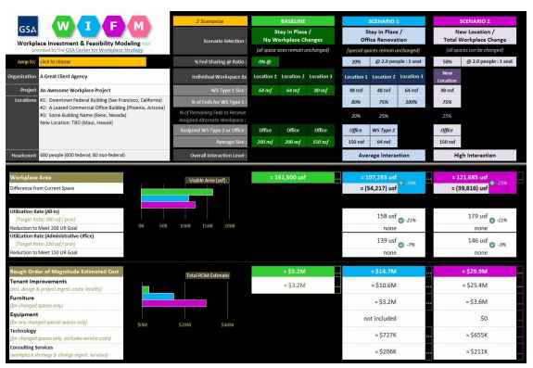
Workplace Investment & Feasibility Modeling (WIFM) Tool
Feasibility Scenarios
Future scenarios using current details
Tests strategies (eg, desk sharing) in achieving space goals
Roughly estimates the cost of change
Starting point for developing workplace requirements
Notes:
Instructions: Blank slide (Dark Background). Use this when none of the existing layouts work for you, and you need to design your own slide. If you have a vision for your slide design, feel free to contact the ME Content Management Team for layout support.

Slide 45
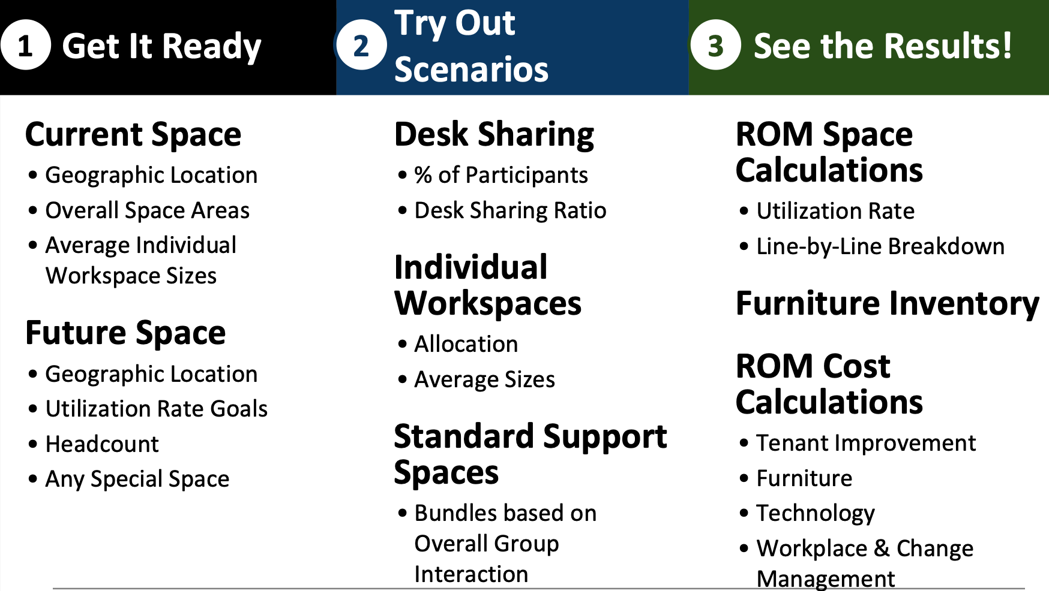
Workplace Investment & Feasibility Modeling (WIFM) Tool
Choose from 3 types of scenarios and up to 3 locations:
Workstations Only
Office Renovation
Total Workplace Change
Notes:
Instructions: Blank slide (Dark Background). Use this when none of the existing layouts work for you, and you need to design your own slide. If you have a vision for your slide design, feel free to contact the ME Content Management Team for layout support.

Slide 46
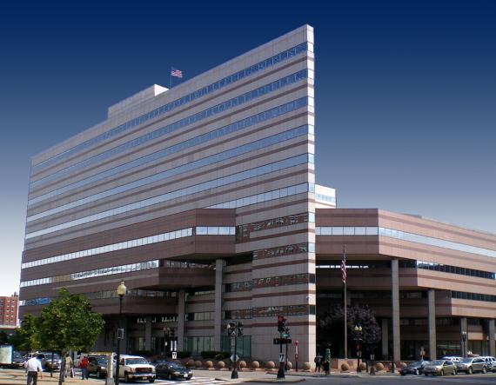
R1 Model Workplace Project
GSA Regional Office
Customer: General Services Administration
Location: O’Neill Federal Building, Boston, MA
Project Overview:
GSA Regional Office Right-Sizing Project
Completed March 2017
48% Space Reduction
Improved Utilization Rate from 288 to 150 USF/Person
Workplace Engagement & Change Management
Notes:
Instructions: Blank slide (Dark Background). Use this when none of the existing layouts work for you, and you need to design your own slide. If you have a vision for your slide design, feel free to contact the ME Content Management Team for layout support.

Slide 47
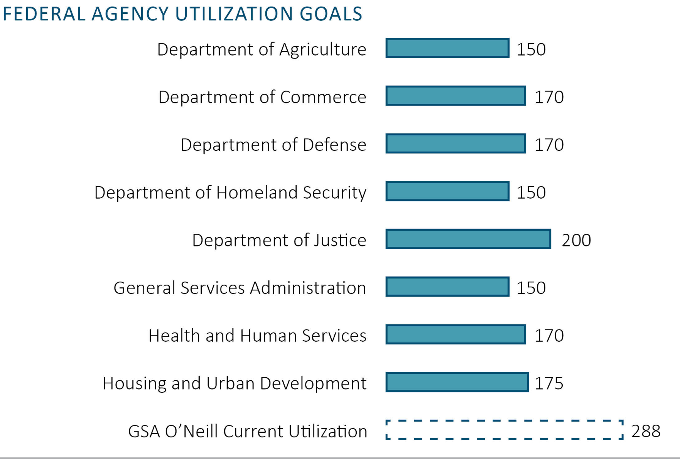
R1 Model Workplace Project
Project Drivers:
OMB Freeze the Footprint, March 2013
GSA Internal Space Policy, May 2014
OMB Reduce the Footprint, March 2015
Project Timeframe:
Workplace Engagement: March - May 2015
Design/Preparation: May 2015 - November 2016
Construction: December 2016 - March 2017
Notes:
Instructions: Blank slide (Dark Background). Use this when none of the existing layouts work for you, and you need to design your own slide. If you have a vision for your slide design, feel free to contact the ME Content Management Team for layout support.

Slide 48
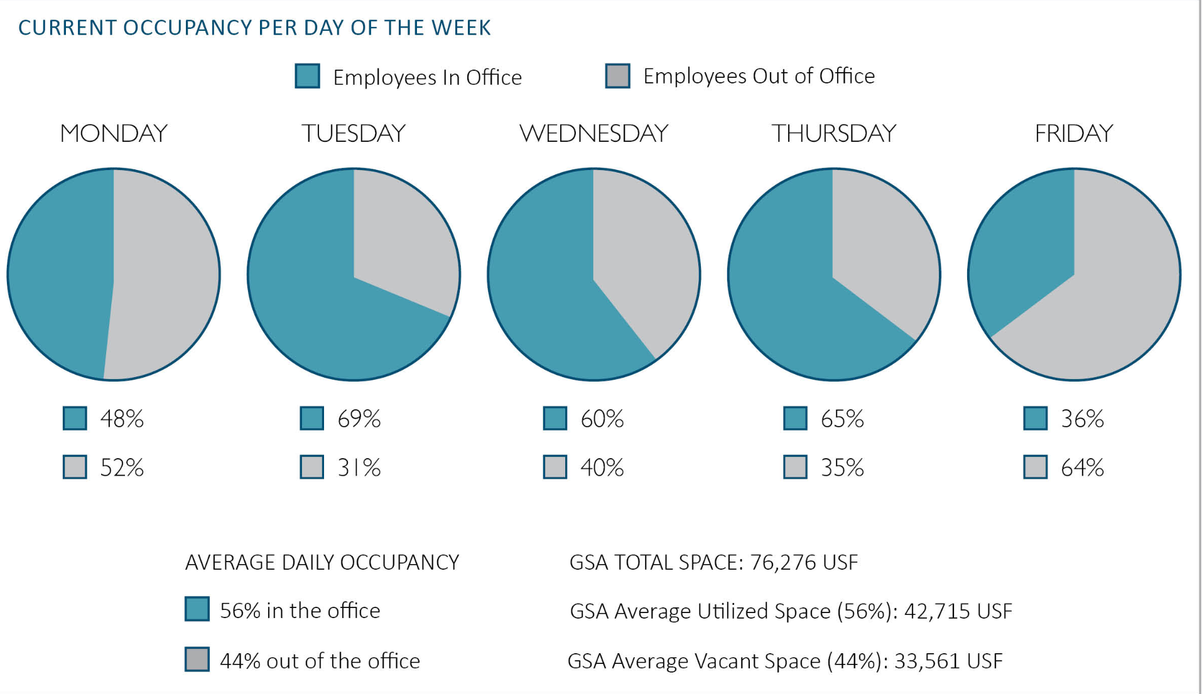
R1 Model Workplace Project
Project Baseline:
Occupy 75k USF on 4 Floors
288 USF/Person
$3.6M Annual Rent
Project Target:
Occupy 40k USF
150 USF/Person
$2M Annual Rent
48% Reduction
Notes:
Instructions: Blank slide (Dark Background). Use this when none of the existing layouts work for you, and you need to design your own slide. If you have a vision for your slide design, feel free to contact the ME Content Management Team for layout support.

Slide 49
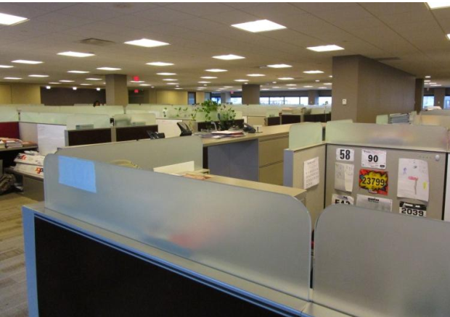
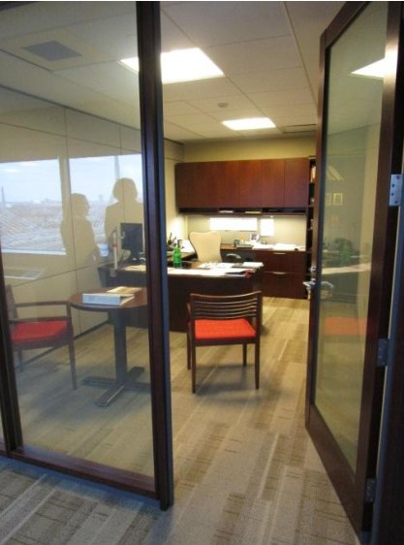
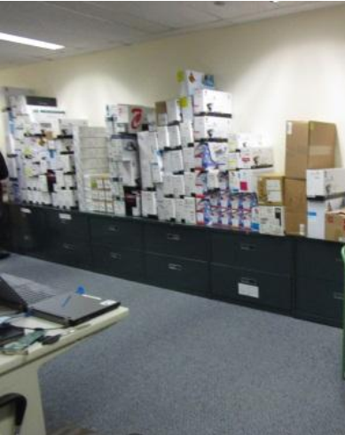
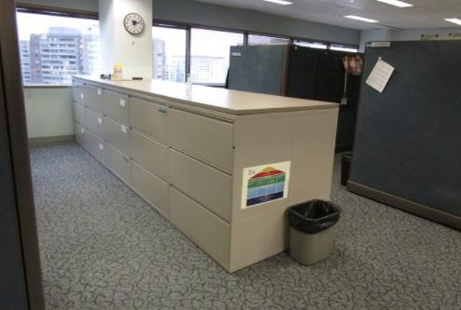
R1 Model Workplace Project
Project Challenges & Opportunities:
Recent renovation completed in 2013
Flexible architecture / furniture
Paper! Digitization Effort
Shared Space
Co-locating multiple divisions
IT Solutions
Managing a mobile workforce
GSA Space Policy
Creating a work environment that people want to come to
Notes:
Instructions: Blank slide (Dark Background). Use this when none of the existing layouts work for you, and you need to design your own slide. If you have a vision for your slide design, feel free to contact the ME Content Management Team for layout support.

Slide 50
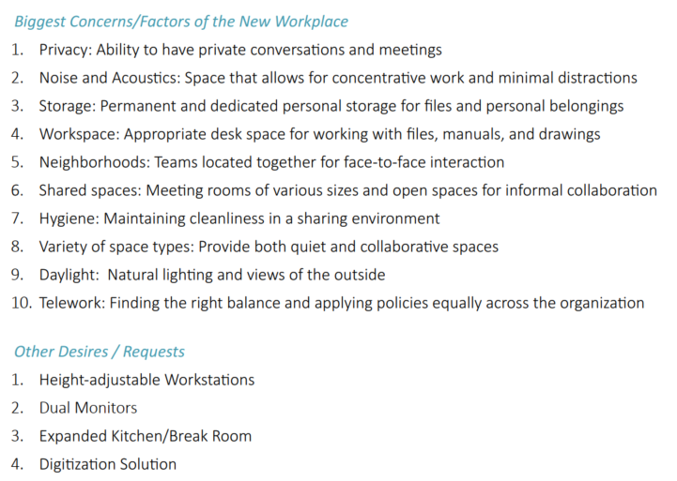
R1 Model Workplace Project
Employee Engagement:
Pre-Occupancy Survey
Expert Walk-through
Leader Visioning Session
Employee Focus Groups
Key Success Drivers:
Strengthen the Community
Work Style Choices
Well-being
Telework & Technology
Knowledge Transfer
Notes:
Instructions: Blank slide (Dark Background). Use this when none of the existing layouts work for you, and you need to design your own slide. If you have a vision for your slide design, feel free to contact the ME Content Management Team for layout support.

Slide 51
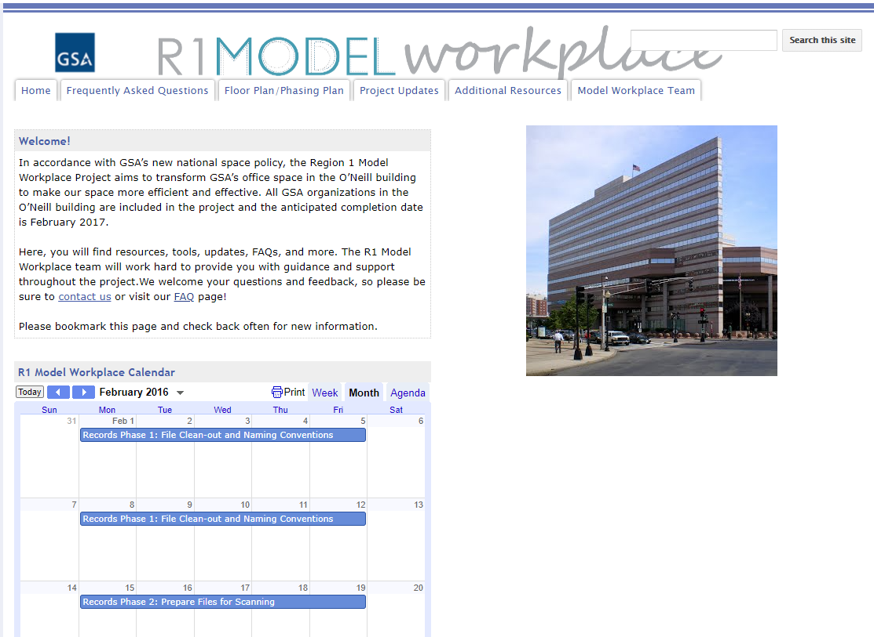
R1 Model Workplace Project
Change Management Effort:
Leading by Example
Employee Engagement & Surveys
Project Website & FAQs
Newsletters & Lobby Displays
All-hands and Staff Meetings
IT and Records Training
Change Champion Team
Workplace Etiquette & Protocols
Workplace Services Team
Notes:
Instructions: Blank slide (Dark Background). Use this when none of the existing layouts work for you, and you need to design your own slide. If you have a vision for your slide design, feel free to contact the ME Content Management Team for layout support.

Slide 52
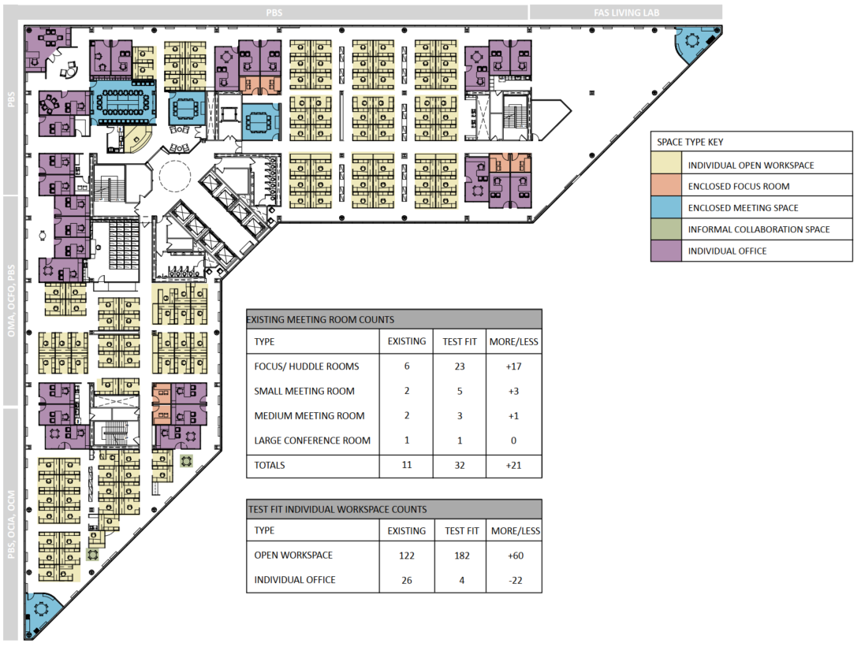
Floor 11 Before
Notes:
Instructions: Blank slide (Dark Background). Use this when none of the existing layouts work for you, and you need to design your own slide. If you have a vision for your slide design, feel free to contact the ME Content Management Team for layout support.

Slide 53
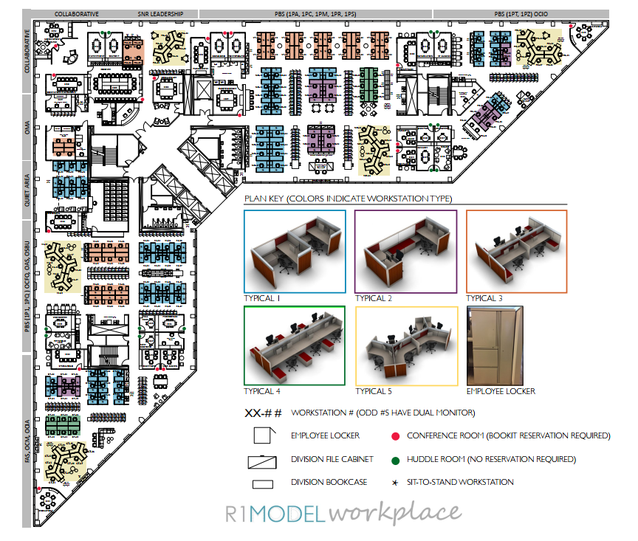
Floor 11 After
Notes:
Instructions: Blank slide (Dark Background). Use this when none of the existing layouts work for you, and you need to design your own slide. If you have a vision for your slide design, feel free to contact the ME Content Management Team for layout support.

Slide 54
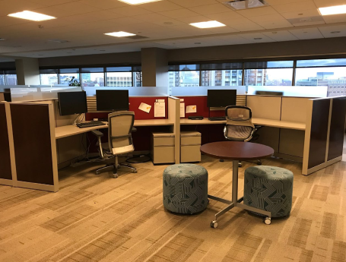
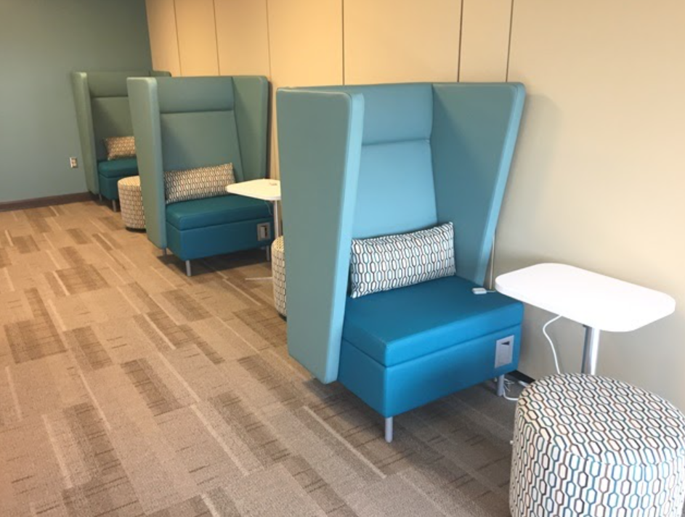
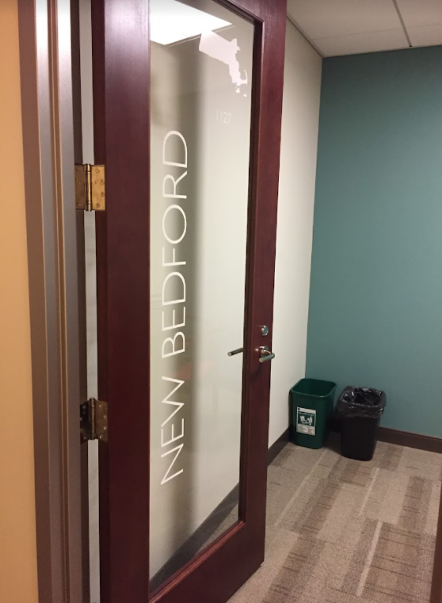
R1 Model Workplace Project
Post Occupancy Survey (February 2018) :
81% found transition to new space to be as expected or easier than expected
70% found the new office to have neutral or positive impact on the way they do their work
“I am surprised at how much I like the new environment. I don't feel as tied down as I had been with an office.
I also feel like I am interacting more with my peers.”
“Overall the move was a success. I think it would be productive to seek feedback more often with surveys like these.”
Notes:
Instructions: Blank slide (Dark Background). Use this when none of the existing layouts work for you, and you need to design your own slide. If you have a vision for your slide design, feel free to contact the ME Content Management Team for layout support.

Slide 55
Future of Workplace Resource Links
The Future of Federal Work Insights
Client Enrichment Series Presentation Video
Workplace 2030 Overview
Workplace Offerings & Resources
GSA Safer Federal-Workplace Site
GSA Safer Workplace Strategy Book
Return to Workplace Services Info Sheet
Activity Based Planning Presentation Video
Activity Based Planning Workplace Matters Publication
WIFM Tool Presentation Video
For more information, contact you Regional Account Manager
Notes:
Instructions: Blank slide (Dark Background). Use this when none of the existing layouts work for you, and you need to design your own slide. If you have a vision for your slide design, feel free to contact the ME Content Management Team for layout support.

Slide 56
Future of Workplace
Q&A
Utilize the Q&A pod to pose
questions to the panelists.

Slide 57
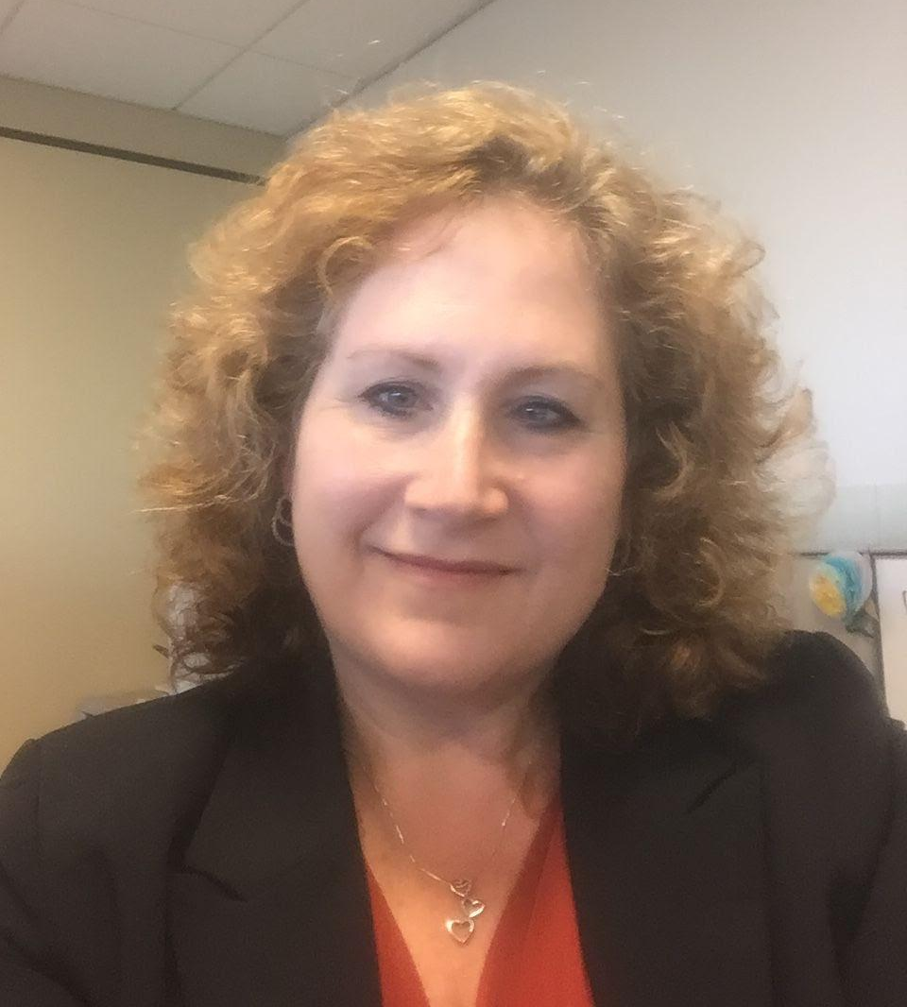
Presented By:
Holli Roberts
Space Management Specialist
Service Centers Division
holli.roberts@gsa.gov
Unique Backfill Opportunity
Notes:
Instructions: Cover Page. This is the cover template. Title placeholders. While not necessary, dual titles can be helpful if you’d like to include a team name, such as (Line 1) “Section 508 Team” (Line 2) “January Metrics Report.” It can also be used to split up a longer title, with the larger part highlighting key words. (Line 1) “How to successfully” (Line 2) “check site accessibility.” Sample can be seen on slide 2. Delete or ignore the blue title line if you do not need multiple lines. Use the subtitle placeholder at the bottom of the screen to note the speaker and/or date of the presentation. TO PRINT: Use black & white mode. These slides are designed for on-screen viewing, and the dark backgrounds use a lot of toner if printed.

Slide 58
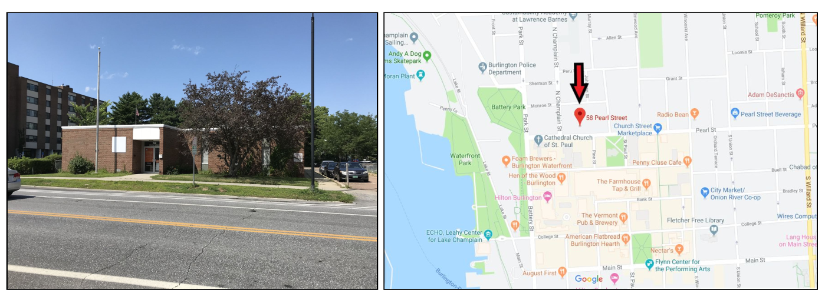
Unique Backfill Opportunity
58 Pearl Street Burlington, VT

Slide 59
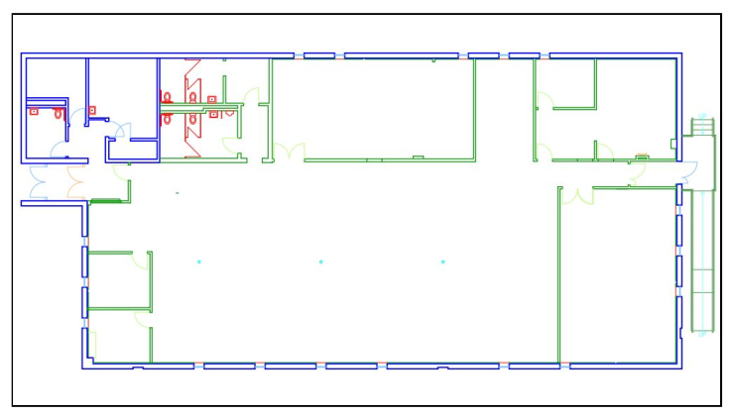
Unique Backfill Opportunity
58 Pearl Street Burlington, VT (cont’d)
Stand-Alone Single Story Building
Single tenant or sub-dividable
6,858 Usable Square Feet
7,661 Rentable Square Feet
Newly renovated interior
Dedicated parking lot
21 surface spaces
2 Blocks from the Burlington
Post Office and Courthouse
Available in 2021
Contact holli.roberts@gsa.gov

Slide 60
Short Break
Gignoux CH, Portland, ME

Slide 61
Presented By:
Barbara J. Salfity
Branch Chief
Real Property Utilization and Disposal
barbara.salfity@gsa.gov
Strategies for Real Property Utilization
Notes:
Instructions: Cover Page. This is the cover template. Title placeholders. While not necessary, dual titles can be helpful if you’d like to include a team name, such as (Line 1) “Section 508 Team” (Line 2) “January Metrics Report.” It can also be used to split up a longer title, with the larger part highlighting key words. (Line 1) “How to successfully” (Line 2) “check site accessibility.” Sample can be seen on slide 2. Delete or ignore the blue title line if you do not need multiple lines. Use the subtitle placeholder at the bottom of the screen to note the speaker and/or date of the presentation. TO PRINT: Use black & white mode. These slides are designed for on-screen viewing, and the dark backgrounds use a lot of toner if printed.

Slide 62
Strategies for Real Property Utilization

Slide 63
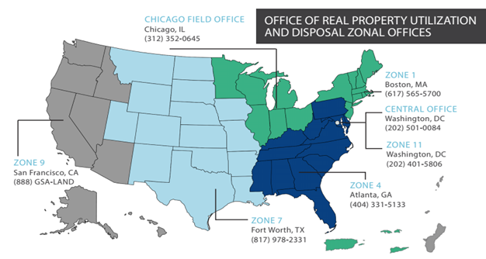
What We Do...Our Mission
Multidisciplinary teams experienced in all aspects of real property utilization
and disposal.
Flexible and responsive to
unique circumstances and developing
affective strategies to address Federal
real property repositioning
Our staff includes:
•Real Estate Experts
•Certified Appraisers
•Auctioneers
•Planners
•Project Managers
•Contracting Officers
Environmental Experts
•Legal Counsel
Leading the Federal Government in optimizing its real property portfolio through effective and tailored disposition and utilization strategies

Slide 64
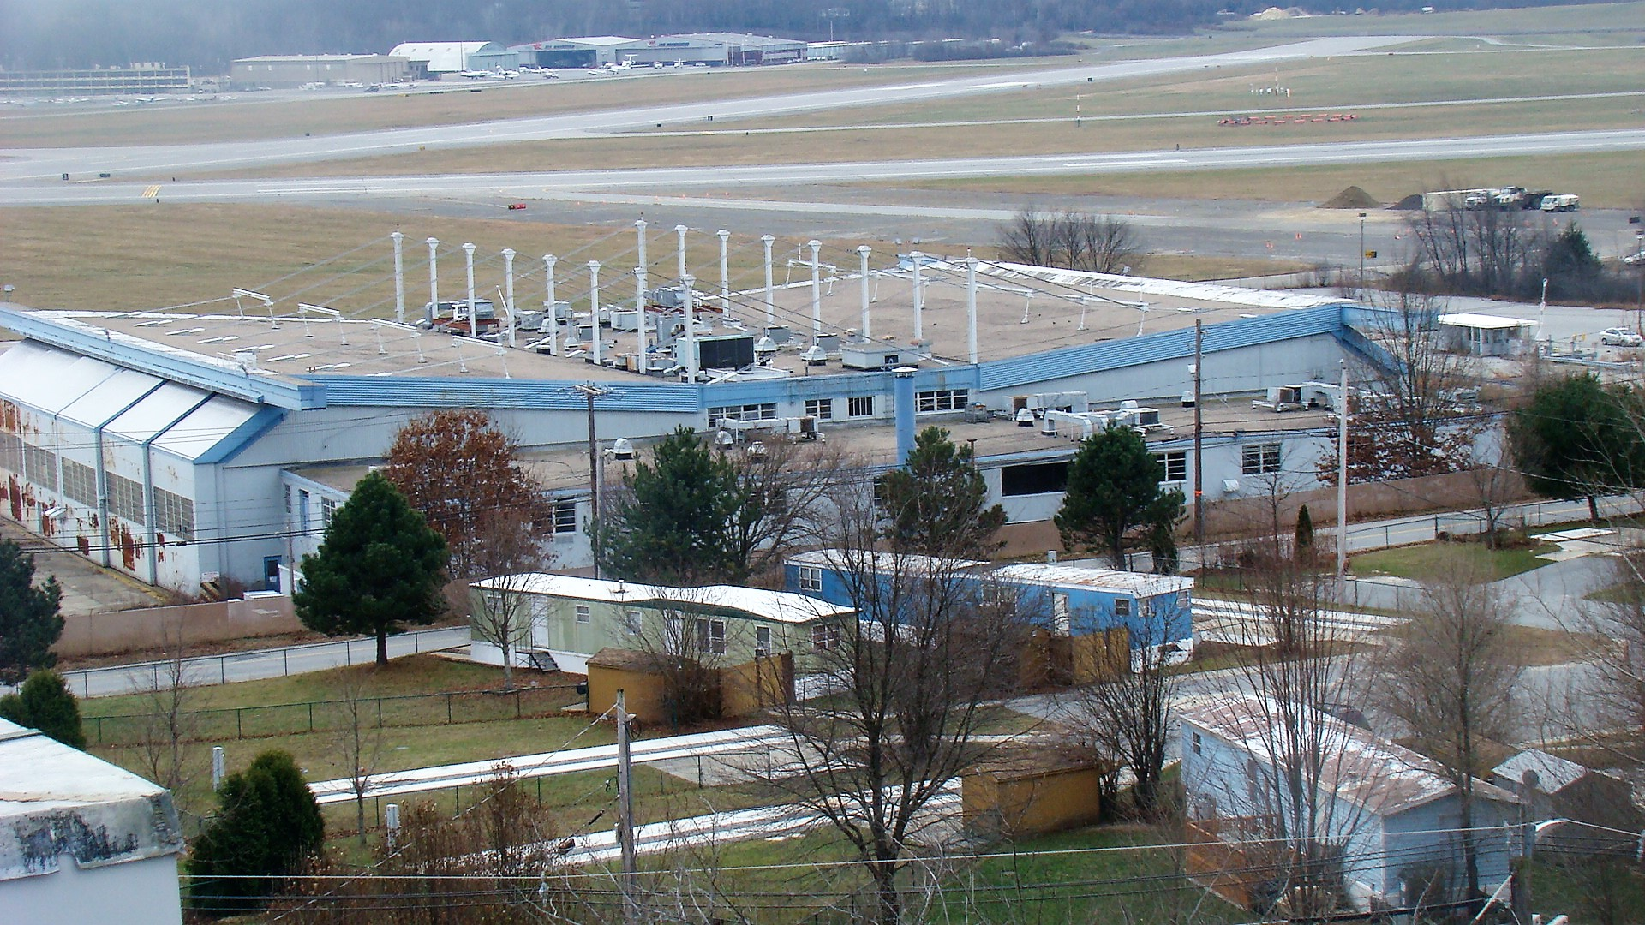
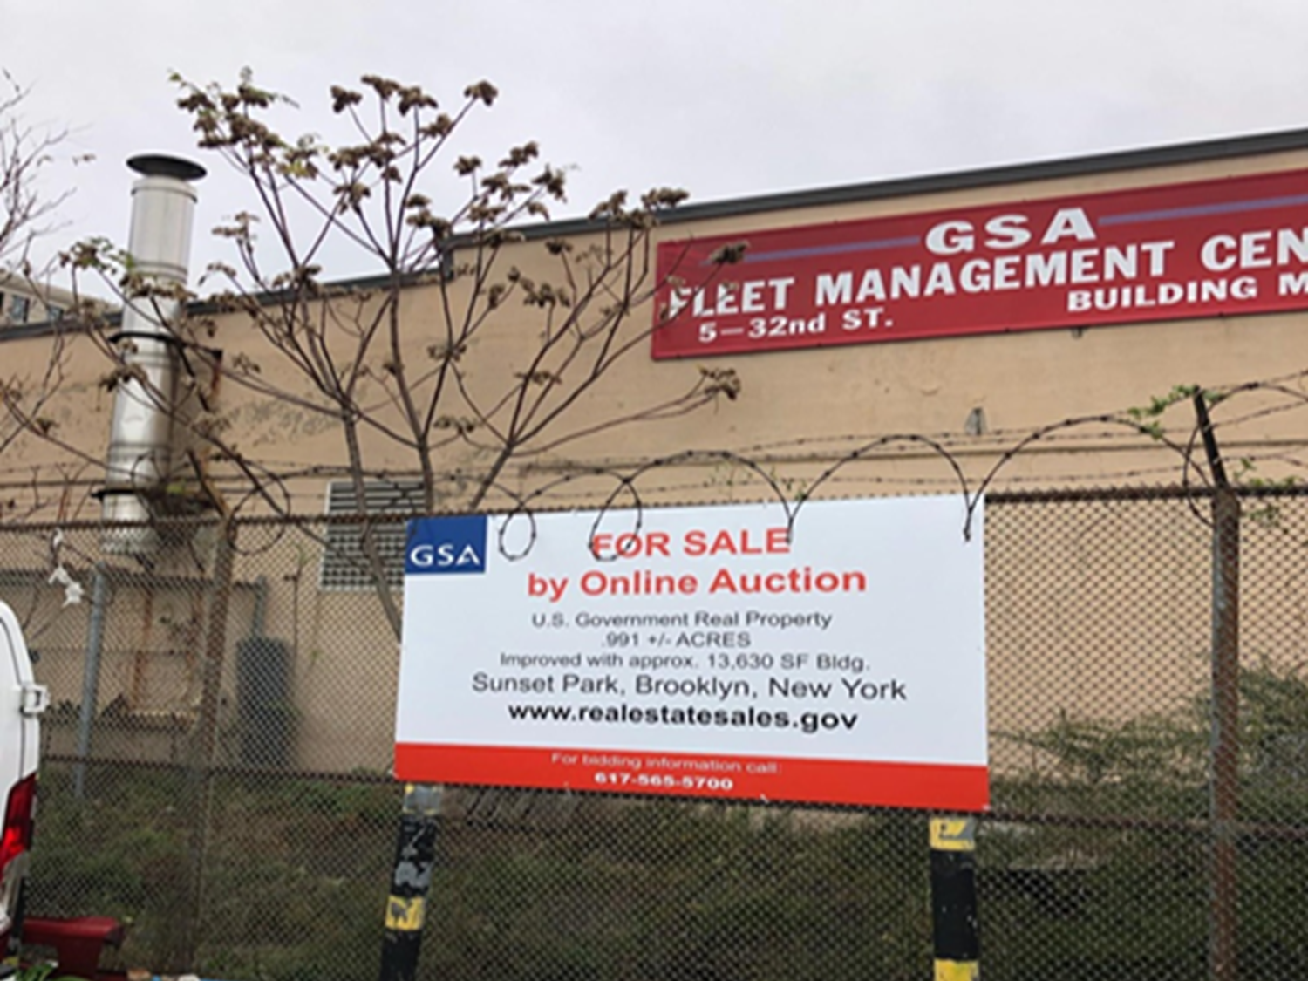
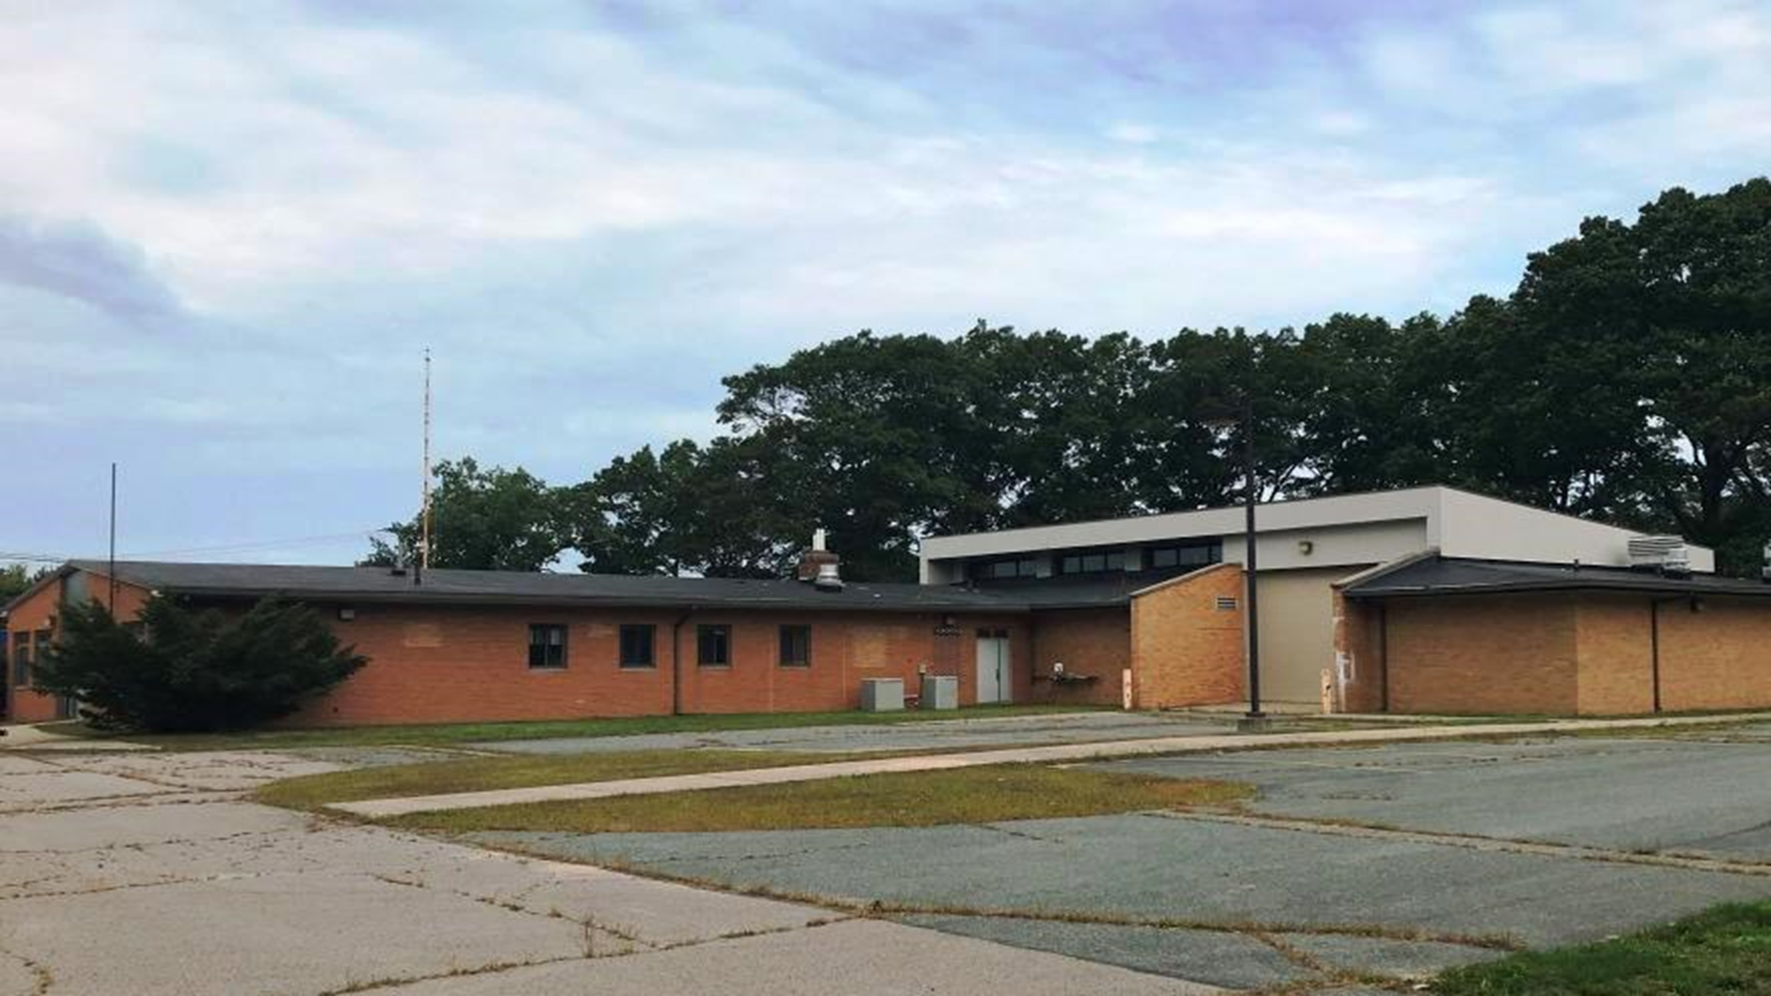
Asset Diversity

Slide 65
Public v. Privately Owned Real Estate
Expectations of Community, Local Officials, and Congress
Compliance with Environmental and Cultural Laws
Balancing Public vs. Monetary Benefits
Unique Title and Infrastructure Concerns
Specialized Government Uses Not Easily Adaptable

Slide 66
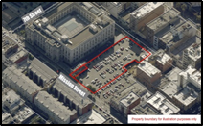
Tailored Strategies
Working with Land Holding Agencies (LHAs), GSA tailors strategies leveraging all available authorities: a flexible approach to finding the best strategy
Unique direct involvement in managing the public process and local outreach
Zonal operation provides extensive market coverage and experience leveraging private sector expertise as required
From due diligence to brokering and closing the transaction
Local Relationships with regulators and other stakeholders key to project success

Slide 67
We Offer Options...Full Range Of Tools & Services
Real Property Due Diligence
• Asset/Disposal Options Studies
• Environmental Characterization/Assessments
• NEPA Reviews
• Land Use Plan/Master Plan Preparation
• Historic Preservation Consultation
• Title Review
• Targeted Asset Reviews
• Facility Condition Assessments
• Energy Audits
• Sustainability Survey
• Report of Excess Preparation
• Land Surveys
• Demolition consultation & analysis
Transaction Management
• Site Acquisition
• Comprehensive Repositioning
(Cradle to Grave Project Management)
• Sales Execution
• Relocation
• Exchange
• Outlease / Sublease
Valuation Services
• Appraisals
• Marketing Studies
Utilization & Disposal Training
• 3-day, client-tailored or multi-
agency training course
• Quarterly webinar series in real
property topics/case studies
• Internal trainings for new hires
and continuing education
• Trainings available in-person
and virtual
Post Disposal Services
• Compliance Surveys
• Release of Restrictions
• Abrogations

Slide 68
Charlestown Navy Yard, Boston, MA

Slide 69
Disposal and Utilization Contract Support Services
Blanket Purchase Agreements (BPA)
Carpenter Robbins Commercial Real Estate
Craddock Group
CBRE
Keres
RSM
Signet
JLL
EMax

Slide 70
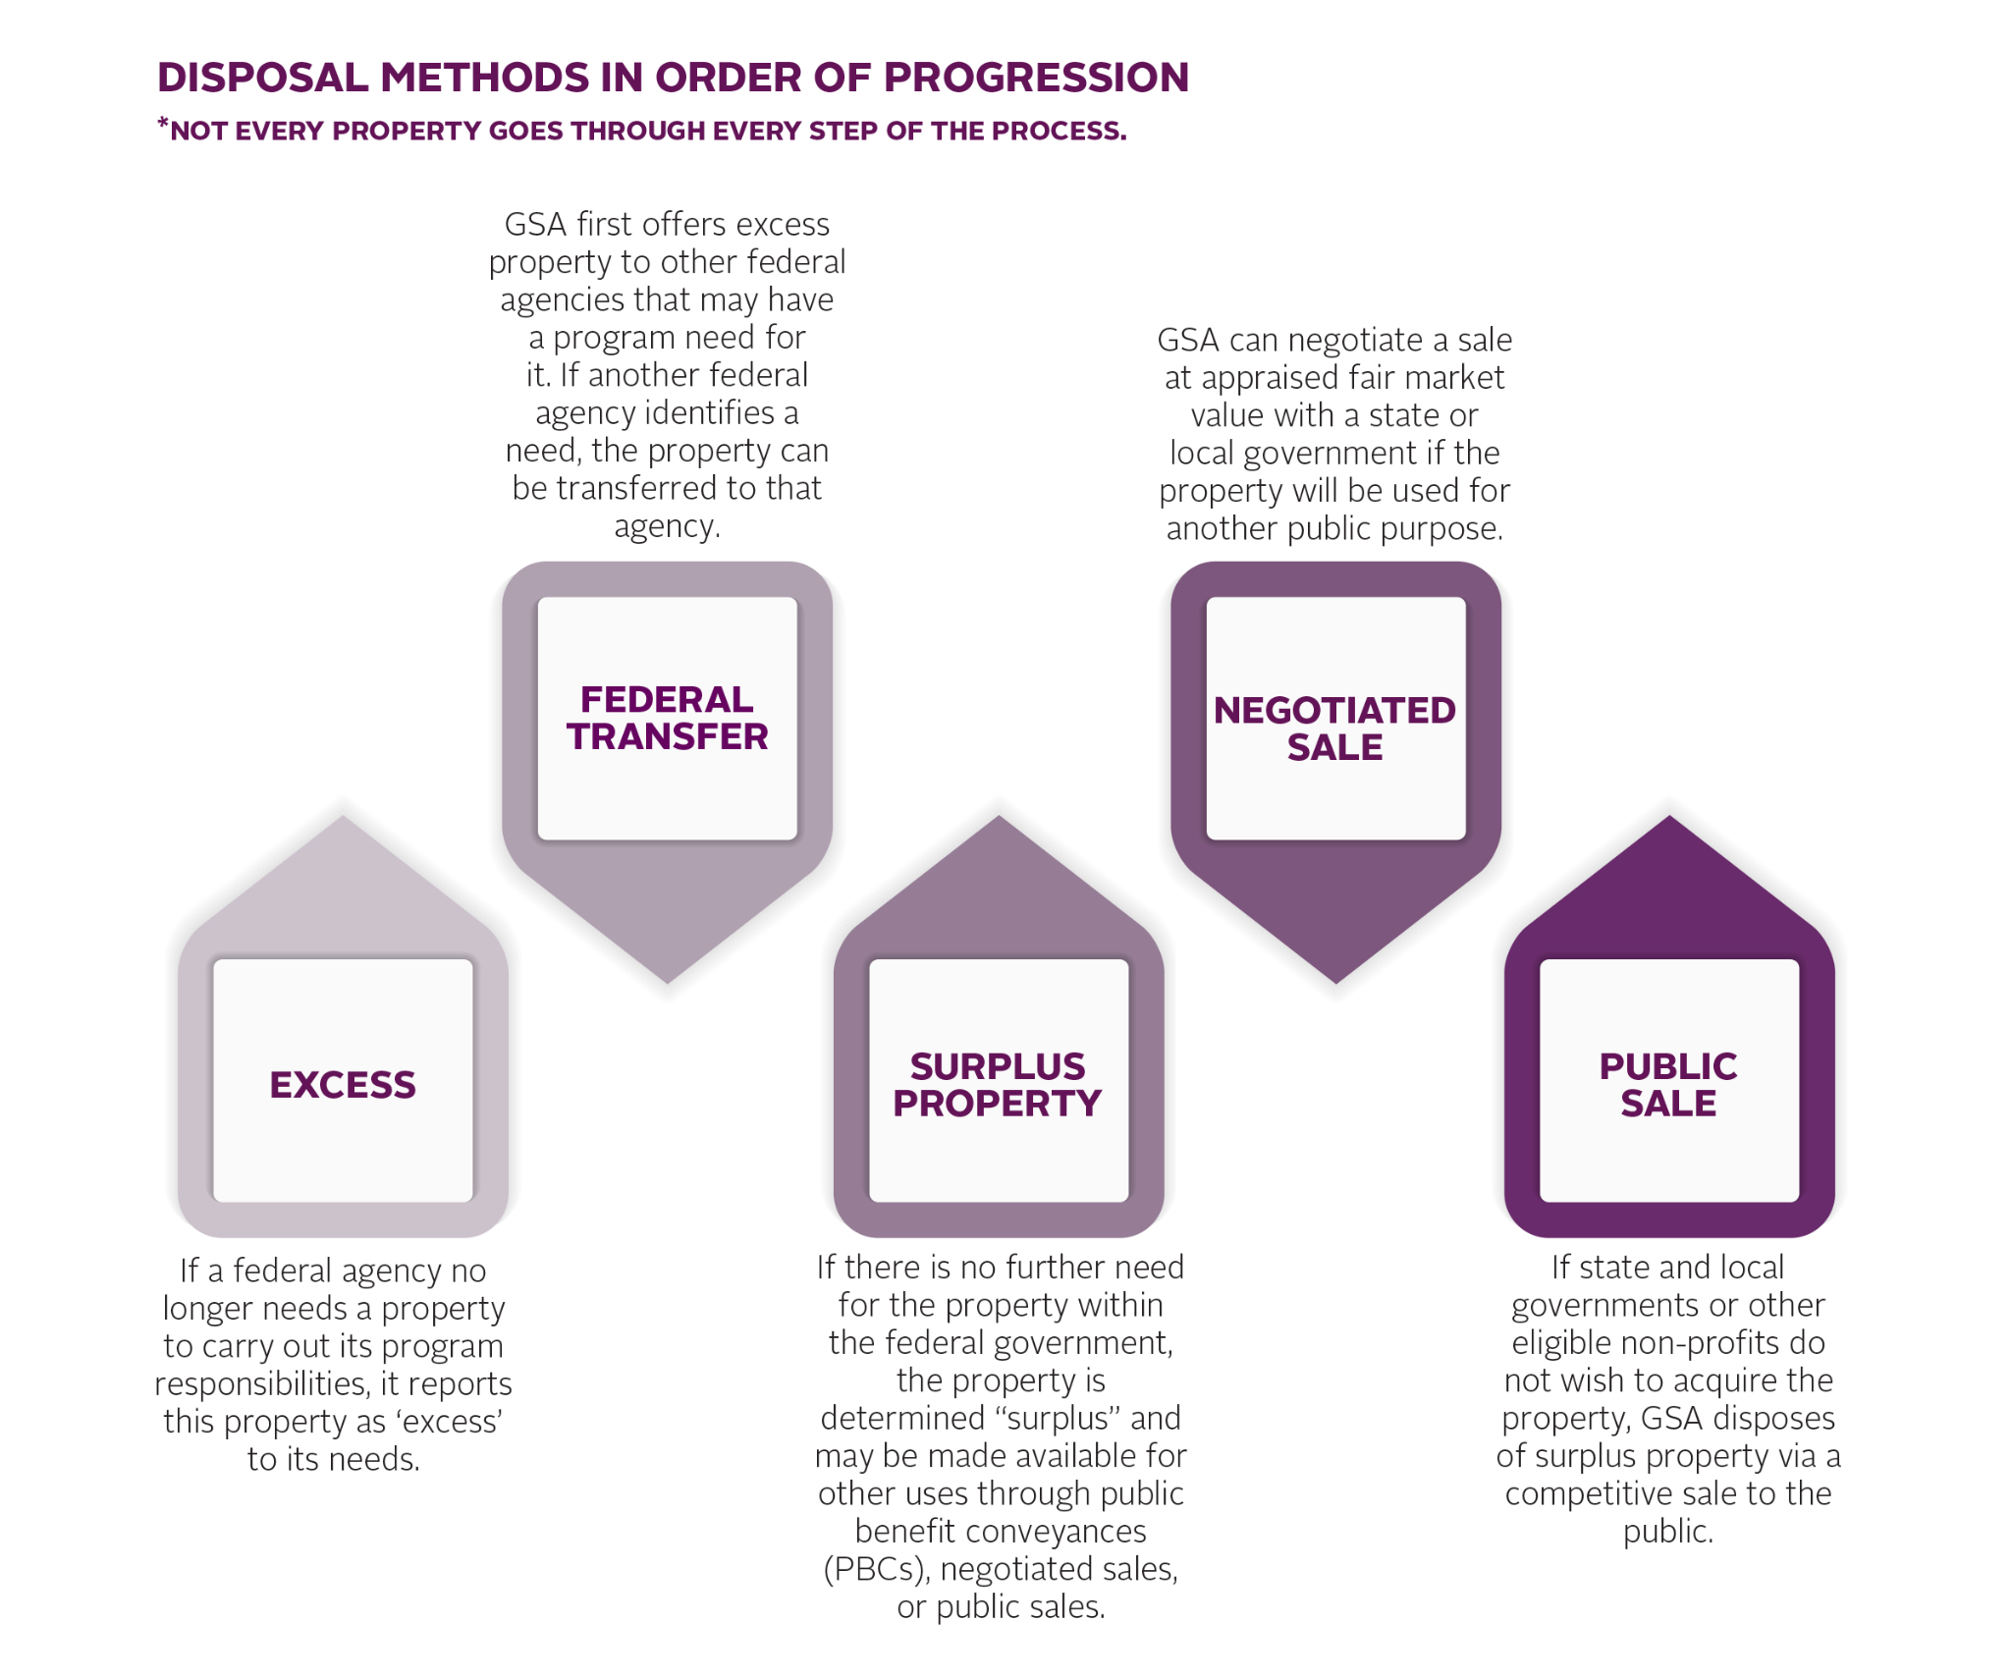
Traditional Disposal Process

Slide 71
Proven Results (FY16 to FY20)
Total Transactions:
Over 700 Deals (Fed Transfers, PBCs, Sales)
Over 75% go to Sale
Total Acres:
Over 50,000 Acres Conveyed
Total Sales:
Over 500 Public Auctions & Sole Source Negotiations
Proceeds:
Over $425M Generated From Sales
Customer diversity:
Provided realty services to more than 20 different bureaus and agencies
Educating Customers Governmentwide:
Held 30 multi-day workshops (both single and multi-agency) for a variety of federal customers

Slide 72
RPU&D Client Agencies Include:
United States Coast Guard
Housing Sales Initiative
Lighthouse Preservation Program
National Park Service
Charlestown Navy Yard
Gateway National Recreation Area
GSA Public Building Service
Department of Energy
Department of Labor
Environmental Protection Agency
Department of Homeland Security
Plum Island
Department of Defense
Army
Navy
Air Force
Corps of Engineers
Department of Transportation
Volpe Transportation Center
Maritime Administration
Department of Agriculture

Slide 73
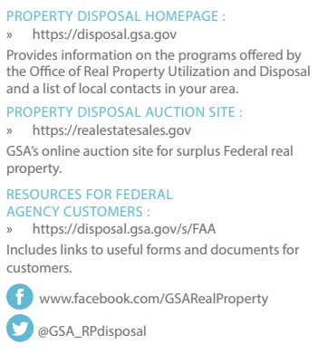
Resources For The Customers We Serve
Notes:
https://disposal.gsa.gov
https://realestatesales.gov
https://disposal.gsa.gov/s/FAA
www.facebook.com/GSARealProperty
@GSA_RPdisposal

Slide 74
Training Resources For The Customers We Serve
FY21 Virtual Workshops
Future Topics
How to Report Real Property Excess
The Federal Real Property Process
How to Report Real Property Excess Electronically
Federal Real Property Asset Management Strategies
Targeted Asset Reviews (TARs) and Other Real Estate Analytics
The Role of Appraisals in the Utilization & Disposal of Real Property
Historic Preservation: Roles and Responsibilities in the Property Disposal Process
Additional Utilization Tools to Leverage Repositioning
Introduction to Environmental Laws Affecting Property Disposal
Federal Real Property: National Environmental Policy Act (NEPA)
Federal Real Property: Comprehensive Environmental Response Compensation and Liability Act (CERCLA)
Federal Real Property: RCRA, USTs, Pesticides, and PCBs; and Coastal Zone Management Act, Floodplains and Wetlands
For information about current offerings and customized workshops tailored to your agency needs, contact:
Gary Jordon
202-841-6995 gary.jordon@gsa.gov
Webinars to assist our Federal Agency customers in better managing their real property assets

Slide 75
Q & A
Zone 1 Management Team
John Kelly
Director
Real Property Utilization and Disposal
john.kelly@gsa.gov
617-565-5700
Barbara Salfity
Branch Chief
Real Property Utilization and Disposal
Barbara.salfity@gsa.gov
Kevin Legare
Branch Chief
Real Property Utilization and Disposal
kevin.legare@gsa.gov
Richard Balsano
Branch Chief- Chicago Field Office
Real Property Utilization and Disposal
Richard.balsano@gsa.gov

Slide 76
Presented By:
Michael D’Alessandro
Branch Chief Customer Service Director
Customer and Stakeholder Engagement (CASE) Division
michael.dalessandro@gsa.gov
Federal Acquisition Service Offerings
Notes:
Instructions: Cover Page. This is the cover template. Title placeholders. While not necessary, dual titles can be helpful if you’d like to include a team name, such as (Line 1) “Section 508 Team” (Line 2) “January Metrics Report.” It can also be used to split up a longer title, with the larger part highlighting key words. (Line 1) “How to successfully” (Line 2) “check site accessibility.” Sample can be seen on slide 2. Delete or ignore the blue title line if you do not need multiple lines. Use the subtitle placeholder at the bottom of the screen to note the speaker and/or date of the presentation. TO PRINT: Use black & white mode. These slides are designed for on-screen viewing, and the dark backgrounds use a lot of toner if printed.

Slide 77
Today’s Agenda
1
Federal Acquisition Service Overview
2
Available Acquisition Resources
3
COVID-19 Resources
4
Other Resources

Slide 78
Federal Acquisition Service (FAS)
Unrivaled capability to deliver comprehensive products and services across government at the best value possible.
Available Solutions:
Products and Services Technology Motor Vehicle Management Transportation Travel; and Procurement and Online Acquisition Tools
gsa.gov/fas
Notes:
Instructions: Blank slide (Dark Background). Use this when none of the existing layouts work for you, and you need to design your own slide. If you have a vision for your slide design, feel free to contact the ME Content Management Team for layout support.

Slide 79
Multiple Award Schedule
Access to more than 11 million commercial supplies and services at volume discount pricing.
Available supplies and services:
Office Management Facilities Furniture & Furnishing Human Capital Industrial Products & Services Information Technology | Miscellaneous Professional Services Scientific Management and Solutions Security & Protection Transportation and Logistics Services Travel
https://www.gsa.gov/buying-selling/purchasing-programs/gsa-schedule
Notes:
Instructions: Blank slide (Dark Background). Use this when none of the existing layouts work for you, and you need to design your own slide. If you have a vision for your slide design, feel free to contact the ME Content Management Team for layout support.

Slide 80
OASIS and HCATS
For use by Government agencies to obtain services.
OASIS (One Acquisition Solution for Integrated Services) Program Management Services Management Consulting Services Logistics Services Engineering Services Scientific Services Financial Services | HCATS (Human Capital and Training Solutions) Customized Training and Development Services Customized Human Capital Strategy Services Organizational Performance Improvement
Notes:
Instructions: Blank slide (Dark Background). Use this when none of the existing layouts work for you, and you need to design your own slide. If you have a vision for your slide design, feel free to contact the ME Content Management Team for layout support.

Slide 81
Network Services and Telecoms
Cost-effective telecom products and services
Available contracts:
Enterprise Infrastructure Solutions (EIS)* Connections II Networx Complex Commercial SATCOM Solutions (CS3) Governmentwide Acquisition Contracts (GWACS) FedRelay Multiple Award Schedule
*EIS Transition:
-Mar 31, 2022: 90% of your agency's telecom inventory must be moved to EIS
-May 31, 2023: Networx, WITS3, and Local Service telecom contracts expire
gsa.gov/telecommunications
Notes:
Instructions: Blank slide (Dark Background). Use this when none of the existing layouts work for you, and you need to design your own slide. If you have a vision for your slide design, feel free to contact the ME Content Management Team for layout support.

Slide 82
Market Research As a Service (MRAS)
High quality, targeted market research, that visually tells a story, and it is FREE.
“...a great benefit to the Government as a whole by simplifying the already complex process of federal acquisition.”
-Jeremy A. Deorsey, CPT, LG
HHD, JFHQ, MAARNG
gsa.gov/mras
Notes:
Instructions: Blank slide (Dark Background). Use this when none of the existing layouts work for you, and you need to design your own slide. If you have a vision for your slide design, feel free to contact the ME Content Management Team for layout support.

Slide 83
COVID-19 Offerings
Cleaning and Disinfection Products | Furniture Products and Services | Professional Support Services
Hand Sanitizers Bleach Disinfecting Wipes Trash Bags | New COVID Furniture NSNs (for privacy and divided space) Hygiene Stations Social Distancing Signage | Enhanced Entry Screening Services (EESS) for Government Facilities
Notes:
Instructions: Lists/set of points on a single slide, NOT numbered. This is for when you want to highlight a list or set of items without visuals, but do not want to number your items. Be brief and to the point; don’t overwhelm your audience with text. If you need additional boxes in your list, work with the ME Content Management Team. Use the Intake Form to request support.

Slide 84
Acquisition Planning Packages
Need sample docs, market research, or guidance?
Facilities
Office Management
Professional Services
Security and Protection
Information Technology
And many more!
Visit: gsa.gov/acquisitionplanningpackage

Slide 85
Meet Your Customer Service Directors:
To advise you on all things GSA
Mike D’Alessandro Branch Chief Customer Service Director 614-543-9645 - michael.dalessandro@gsa.gov | Department of Defense State and Local Environmental Protection Agency
Annie Khun Customer Service Director 617-645-1864 - annie.khun@gsa.gov | Dept of Homeland Security Dept. of Veterans Affairs Dept of Interior
Christin Gurgo Customer Service Director 781-460-1429 - christin.gurgo@gsa.gov | U.S. Air Force Dept. of Justice
Steve Hennessy Customer Service Director 857-272-8743 - steve.hennessy@gsa.gov | Department of Defense U.S. Air Force

Slide 86
Federal Acquisition Service
Q&A
Utilize the Q&A pod to pose
questions to the panelist.

Slide 87
Presented By:
Carey Bergeron
Program Specialist
Office of the Regional Commissioner
carey.bergeron@gsa.gov
Climate Resilience
Adapting and Responding to Climate Change
Notes:
Instructions: Cover Page. This is the cover template. Title placeholders. While not necessary, dual titles can be helpful if you’d like to include a team name, such as (Line 1) “Section 508 Team” (Line 2) “January Metrics Report.” It can also be used to split up a longer title, with the larger part highlighting key words. (Line 1) “How to successfully” (Line 2) “check site accessibility.” Sample can be seen on slide 2. Delete or ignore the blue title line if you do not need multiple lines. Use the subtitle placeholder at the bottom of the screen to note the speaker and/or date of the presentation. TO PRINT: Use black & white mode. These slides are designed for on-screen viewing, and the dark backgrounds use a lot of toner if printed.

Slide 88
Today’s Agenda
1
Regional Overview
2
New England Federal Partners Participation
3
Moakley Courthouse
Notes:
Instructions: Agenda Option 1C. This is a similar option for how you can structure an agenda, but with even less slots. Add or remove rows in SLIDE > EDIT MASTER. Use the Intake Form to request support.

Slide 89
What is Resilience?
Response and Adaptation to Climate Change
Actions taken to maintain existing systems and structures
Renew, develop, and innovate to improve the ability of systems and structures to adapt to small and large changes
Notes:
Instructions: Blank slide (Dark Background). Use this when none of the existing layouts work for you, and you need to design your own slide. If you have a vision for your slide design, feel free to contact the ME Content Management Team for layout support.

Slide 90
Climate Change Impacts in New England
Extreme Precipitation Events
Sea Level Rise & Lake/River Flooding
Drought
Notes:
Instructions: Lists/set of points on a single slide, numbered. This is for when you want to highlight a list or set of items without visuals. Be brief and to the point; don’t overwhelm your audience with text. If you need additional boxes in your list, work with the ME Content Management Team. Use the Intake Form to request support.

Slide 91
Climate Change Risk Analysis
Design Criteria
Critical Infrastructure
Stormwater
Water Intrusion
Managements system
Drainage
Entryways
Ventilation intakes
Exhaust locations
Minimum height above sea level
Backup systems
Notes:
Instructions: Set of ideas/points on a single slide. This is for when you want to highlight a set of ideas. Be brief and to the point; don’t overwhelm your audience with text. If you need additional boxes, work with the ME Content Management Team. Use the Intake Form to request support.

Slide 92
Future of Climate Resiliency
Regional Focus
Audit buildings to prioritize risk
Adding Climate Change to Guiding Principles Checklist
Climate Resiliency/Flood Mitigation for all projects
Notes:
Instructions: Lists/set of points on a single slide, NOT numbered. This is for when you want to highlight a list or set of items without visuals, but do not want to number your items. Be brief and to the point; don’t overwhelm your audience with text. If you need additional boxes in your list, work with the ME Content Management Team. Use the Intake Form to request support.

Slide 93
New England Federal Partners
Multiple agency cooperation to protect the natural environment and public health and support the needs of states, Tribes, and communities of New England.
Formed to work on complex environmental issues of concern to the NE Region and its states
Coordinate across federal programs to communicate and collaborate effective solutions to issues of shared interest
A vision co-created by over 100 experts from 18 agencies
Notes:
Instructions: Blank slide (Dark Background). Use this when none of the existing layouts work for you, and you need to design your own slide. If you have a vision for your slide design, feel free to contact the ME Content Management Team for layout support.

Slide 94
New England Federal Partners
FOCUS
Developed NE Ocean Plan to conserve marine resources
Provide content for Climate Resilience Toolkit (Toolkit.climate.gov)
Collaborate on inter-agency regional issues such as drought, floods, climate change, sedimentation, and coastal assessment and management
Notes:
These services must adapt and expand to support the evolution of work over time

Slide 95
Moakley Courthouse
Formed the GSA New England Vulnerability Assessment Working Group
Participated on National Climate Risk Management calls
Attended local Stakeholder meetings sponsored by the State and City groups working towards the same goal citywide
Conducted a Risk Mitigation Alternatives Analysis
Design controls such as watertight and/or water resistant mechanical equipment be considered when equipment is being replaced
Reviewed the Climate Ready South Boston Report
Attended the Climate Change Program at the Moakley Courthouse
Notes:
Instructions: Blank slide (Dark Background). Use this when none of the existing layouts work for you, and you need to design your own slide. If you have a vision for your slide design, feel free to contact the ME Content Management Team for layout support.

Slide 96
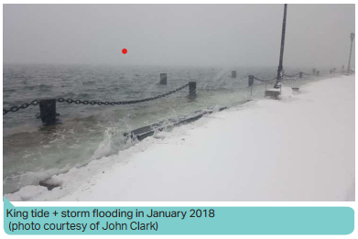
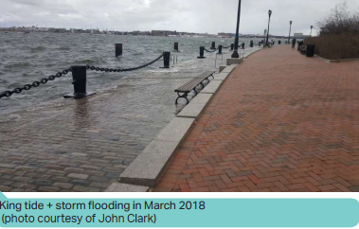
Moakley Courthouse
January and March
2018 High Tide plus flooding events
demonstrate changing
conditions and cause for
elevated concern
Notes:
Instructions: Blank slide (Dark Background). Use this when none of the existing layouts work for you, and you need to design your own slide. If you have a vision for your slide design, feel free to contact the ME Content Management Team for layout support.

Slide 97
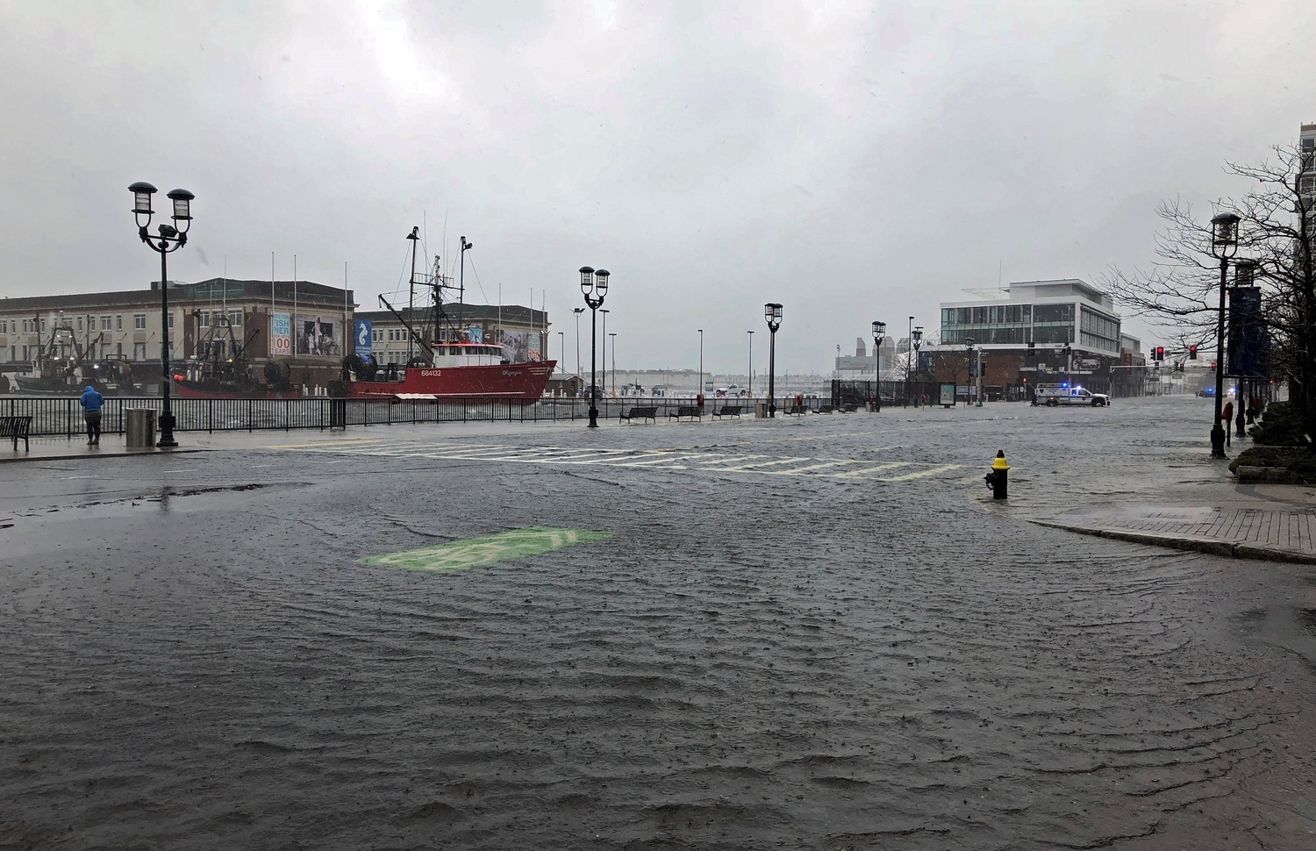
Moakley Courthouse
2019 Flood Mitigation Study
US Courts National Facilities Program looking at Moakley Courthouse Climate Resilience as best practices across the agency
GSA working closely with Courts
Notes:
Instructions: Blank slide (Dark Background). Use this when none of the existing layouts work for you, and you need to design your own slide. If you have a vision for your slide design, feel free to contact the ME Content Management Team for layout support.

Slide 98
Climate Resilience
Q&A
Utilize the Q&A pod to pose questions to the panelist.

Slide 99
Closing Remarks
From Senior Leadership
Thank you for joining!
For questions following the live event, utilize the GSA directory.
For administrative questions, email Region01customerforum@gsa.gov
Notes:
Instructions: Cover Page. This is the cover template. Title placeholders. While not necessary, dual titles can be helpful if you’d like to include a team name, such as (Line 1) “Section 508 Team” (Line 2) “January Metrics Report.” It can also be used to split up a longer title, with the larger part highlighting key words. (Line 1) “How to successfully” (Line 2) “check site accessibility.” Sample can be seen on slide 2. Delete or ignore the blue title line if you do not need multiple lines. Use the subtitle placeholder at the bottom of the screen to note the speaker and/or date of the presentation. TO PRINT: Use black & white mode. These slides are designed for on-screen viewing, and the dark backgrounds use a lot of toner if printed.

