Slide 1
Surety Bond Guarantee Program for Small Businesses
sba.gov/osg

Slide 2


sba.gov/osg
Notes:
(Link to embedded video if needed: SBA Surety Bonds for Small Businesses – YouTube)

Slide 3

SBA guarantees contract bonds
A variety of bond types and amounts:
1
Bid
2
Performance
3
Payment
4
Maintenance
For each government and private
contract up to $9 million.
For each direct federal contract up to $14 million.

Slide 4

We help small businesses facing barriers to success by creating access and opportunity for them to qualify for contract bonding, increase bonding capacity, and grow their business.

Slide 5

Providing access and creating stability
You gain access to bid, performance,
payment, and maintenance bonds.
Our guarantee allows small businesses to qualify for more bonding.

Slide 6
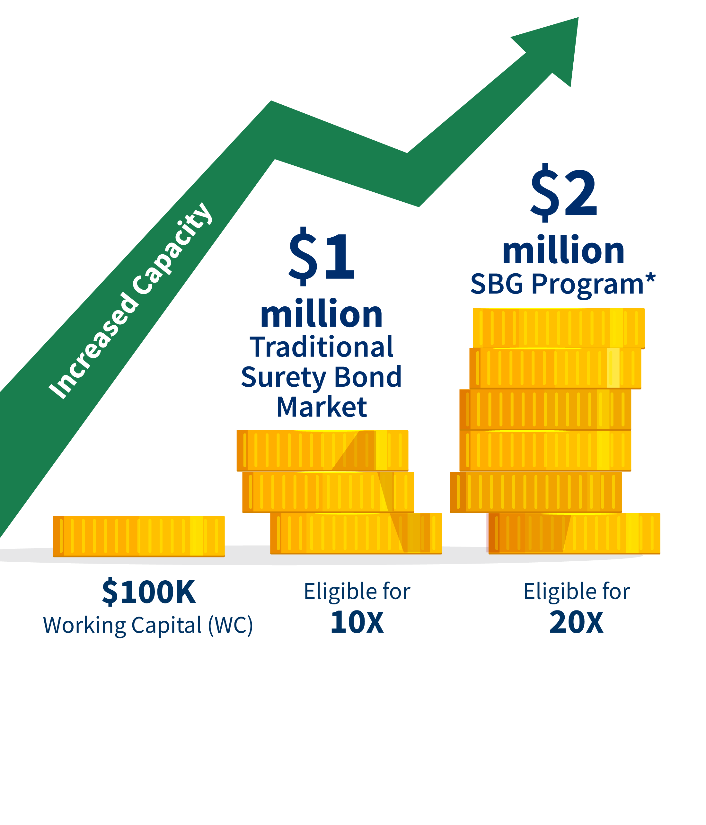
Benefits of SBA guaranteed bonds
  Working capital required is about half what is normally needed for contract bonds.
  We count the unused portion of working capital bank lines of credit.

Slide 7

Prior Approval Program and QuickApp =
Fast decisions to meet your needs
Prior approval program delivers underwriting decisions in 2 days.
QuickApp decisions within 24 hours on bonds of $500,000 or less.

Slide 8

Typical surety bond fees
Bid bond guarantee fees
are never charged by the SBA.
Contractor’s fee
0.6% of the contract amount paid to SBA for the guarantee.
Surety premium
charge paid to the surety company for the bond.

Slide 9

Find an SBA authorized agent
Visit
sba.gov/osg

Slide 10

Vera Hall, Small Business Owner
“The ability to get this type of bonding through the SBA’s Surety Bond Guarantee program allows you as a small business owner to realistically compete with larger corporations for contracts that you want and need to grow your business.”
Let the SBG Program help your business grow.

Slide 11
Small Business Resources
Find an SBA Authorized bond agent:
Surety bonds | U.S. Small Business Administration (sba.gov)
Learn more about bonding & the surety underwriting process & find project resources for free:
NASBP Learning: NASBP SFAA

Slide 12
Thank you!
Any questions?
Presenter contact information
Tamara E. Murray
Underwriting Marketing Specialist
(303) 927-3479
tamara.murray@sba.gov
sba.gov/osg

