Slide 1
Veteran Small Business Certification Program
(VetCert)

Slide 2
From the Administrator
Goal: Increase the VOSB and SDVOSB industrial base
Objectives:
  Simplify the preparation and submission of certification documentation and data
  Streamline the certification review process without compromising due diligence
  Shift resources and funding from certification activities to training and growth activities
The program is a top priority for SBA Administrator Isabella Casillas Guzman to ensure that veteran and service-disabled veteran business owners receive their certification and have access to the federal marketplace.
VOSB = Veteran-Owned Small Business
SDVOSB = Service-Disabled Veteran-Owned Small Business

Slide 3
Veteran Small Business Certification Program
The National Defense Authorization Act of 2021 officially requires VA's CVE responsibilities to be transferred to the SBA as of Jan 1, 2023, and for the SBA to establish a government-wide certification program.
The SBA program name for certifying VOSBs and SDVOSBs is the Veteran Small Business Certification Program, or VetCert.
The final rule for the program was published on November 29, 2022, in the Federal Register.
The program launched to the public and began accepting new applications on January 9, 2023.
  Veterans.certify.sba.gov
Notes:
MySBA
The SBA is developing a platform that will bring all certification, lending, and available resources under one integrated portal.

Slide 4
Today’s Discussion
SBA’s VetCert Program
Overview
New Certification Rules
Benefits
Eligibility
Certification
Tips
VetBiz Central Resources

Slide 5
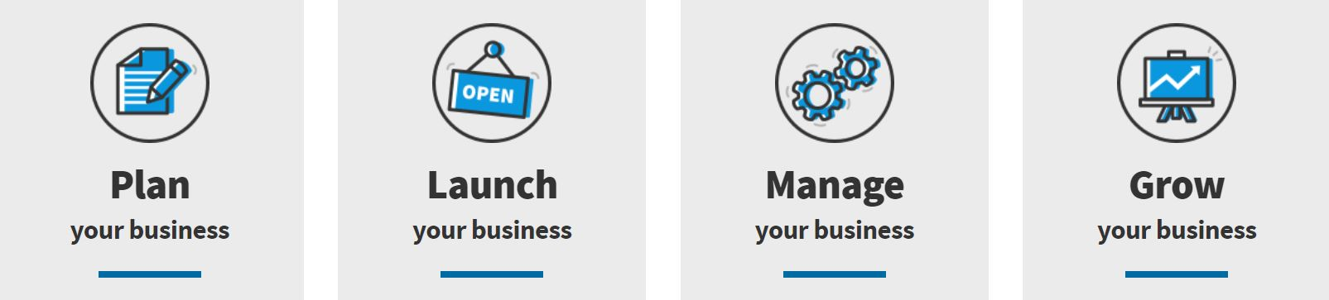
Our Mission: Supporting small businesses for 70 years
The U.S. Small Business Administration makes the American dream of business ownership a reality.
We empower entrepreneurs and small business owners with the resources and support they need to start and grow their businesses and help with recovery nationwide after a disaster.
Created in 1953, the SBA is the only go-to resource and voice for small businesses backed by the strength of the federal government.
Notes:
Small businesses and innovation are critical to this region’s – and the nation’s – success and that’s what the SBA is here to support: those looking to pursue the American dream of business ownership.
America’s 30 million small businesses– are the engines of our economy and when they do well, our communities do well. In fact, they create 2 out of every 3 jobs.
The economy is thriving, unemployment is at its lowest rate in 17 years, the U.S. has added jobs month over month and wage growth is at its fastest since 2009.

Slide 6
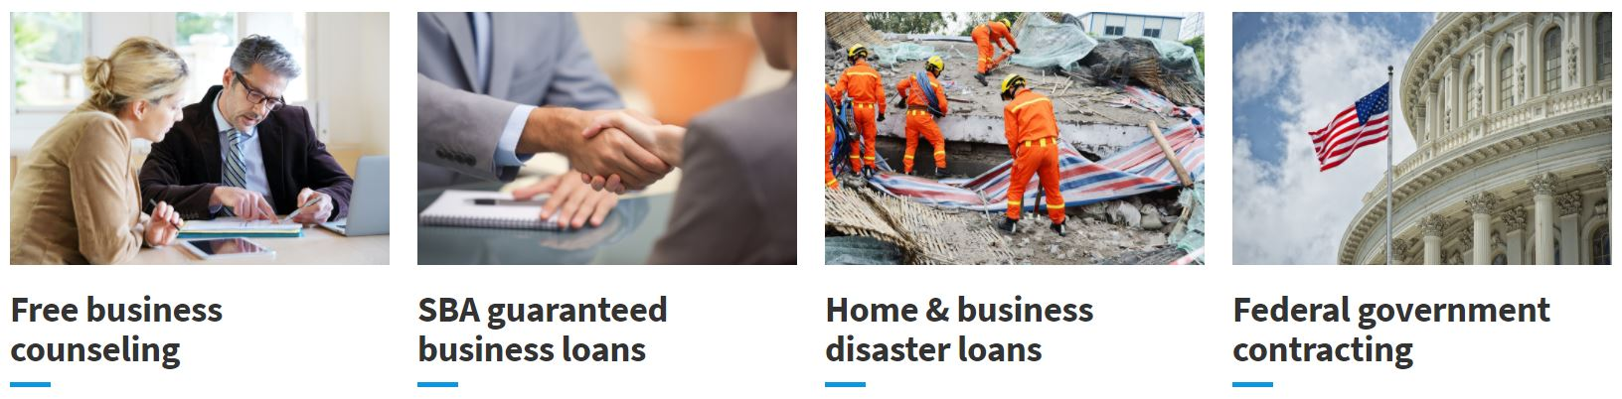
How We Help: Four areas supporting success
The SBA is the go-to resource for access to capital, valuable resources, business know-how, and the right expertise for every stage of your business lifecycle.
Notes:
When many think of the SBA, money is what first comes to mind. And sometimes that’s also accompanied with the thought of paperwork, red tape and regulation because we are a federal agency. Today I’m going to address both of these.
First, funding for small businesses is only one part of the work that we do. We also offer counseling, access to government contracting and help with recovery after a disaster. I’ll go into deeper detail of each of these.
Second, our standing as a federal agency is a positive. We serve as the only voice for small businesses nationwide backed by the federal government and advocate for them at the President’s Cabinet level. Also, we’ve been working hard to remove burdensome regulations and eliminate red tape so small businesses can spend less time working to comply with government regulations and more time focusing on growing their business. In fact, we’ve exceeded the goal of cutting two old rules for every new one. And, the Tax Cuts and Jobs Act is also designed to deliver results, incentivizing businesses to build, grow and hire in America.

Slide 7
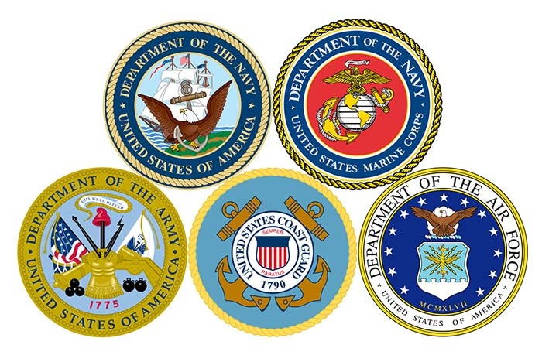
THANK YOU!

Slide 8
Highlights of the New SBA Certification Program
Along with the transfer to the SBA, there are changes to both the process and system to receive certification and make it easier for owners to have someone assist them in preparing their application.
After the grace period expires for SDVOSBs, all VOSBs and SDVOSBs will be expected to be certified by the SBA to receive sole source or set aside awards from federal agencies.
Agencies will continue to receive SDVOSB goaling credit for awards made to self-certified SDVOSB on non-SDVOSB set aside or sole source contracts. The SBA intends to reevaluate self-certification for goaling purposes once this program is launched.
The SBA VetCert program provides reciprocal certification for businesses with remaining eligibility in the WOSB and 8a programs.
Business-friendly approach to ownership requirements that aligns veteran certifications with the 8a and WOSB programs.
Joint ventures do not require certification although the managing partner must be SBA certified and the joint venture must request designation.

Slide 9
Policy Highlights – Key Changes
SDVOSBs need to be certified by the SBA to receive sole-source or set aside contracts from any federal agency
  SDVOSB government-wide goal is still 3%
  Agencies can still rely on self-certification for goaling purposes
VOSBs continue to need to be certified for sole-source and set aside contracts from the VA under its Vets First Authority
  Other federal agencies do not have a mandate or authority to award contracts to VOSBs
The SBA has both the certification system (for small businesses to apply/reapply) and the search tool (for the public & acquisition professionals)
  SAM.gov will not accurately reflect SDVOSB/VOSB certification status
WOSB and 8(a) firms will have their certifications recognized if the qualifying individual(s) are the same across programs
Notes:
MySBA
The SBA is developing a platform that will bring all certification, lending, and available resources under one integrated portal.

Slide 10
Policy Highlights – Key Changes (cont.)
One Year Extension - Companies that were verified by the VA Center for Verification and Evaluation (VA CVE) prior to January 1, 2023, have automatically received a 1-year extension to their program term (4 years vs. 3 years)
One Year Grace Period - Companies may self-certify through 2023, but must also submit an application to SBA for a final determination
Certification will not be for a specific NAICS code - SBA’s certification process determines that a business is currently small in at least one NAICS code listed in the firm’s SAM.gov profile. To avoid restricting a certified VOSB/SDVOSB’s ability to expand its operations into new industries, a firm must only qualify under the size standard corresponding to the NAICS code assigned to a specific contract.
Final Rule takes steps to harmonize & simplify definitions of ownership, control, day to day operations, and standard hours across certification programs
OHA handles appeals & protests
Surplus Property Program is opened to VOSB & SDVOSB businesses
Notes:
One Year Extension:
Companies do not need to take any further action to receive this extension; the date will automatically be updated in the SBA Search Tool for SD/VOSBs
VA is working to process all applications/recertifications submitted prior to its closure of its system in October
One Year grace period: Self certification will still take place in SAM.gov
MySBA
The SBA is developing a platform that will bring all certification, lending, and available resources under one integrated portal.

Slide 11
Benefits of SBA Certification
The SBA provides small businesses the opportunity to access resources such as training, business counseling, access to capital, and more.
Most resources such as counseling, training, classes, financial readiness assessments, etc., are offered at little to no cost to all small businesses.
Certification allows firms the opportunity to compete in the federal marketplace and for sole-source and set-aside contracts. Self-certified firms do not qualify for VA contracting opportunities.

Slide 12

WIIFM??

Slide 13
Government-Wide Contracting Goals
COMPETITION TYPES TO WIN GOVERNMENT CONTRACTS
01
Full and Open
Competition
WORLD’S
LARGEST
BUYER
02
Small Business
Set-Asides
$650 billion/year
23% federal contract dollars are intended for small businesses
03
Sole Source
Notes:
The Government is considered the “World’s Largest Buyer.”
Purchases by military and civilian installations amount to nearly $500,000 billion a year.
The Government’s procurement policy which encourages prime and subcontracting opportunities for small businesses is a catalyst for economic growth.
Federal statute defines government-wide prime contracting goals which represent a primary tool in helping small firms be considered for government contracts.
The current, government-wide procurement goal is at least 23% of all federal contracting dollars.
Three methods of limiting competition to win government contracts include: Full and Open Competition, Small Business Set Asides including certification-based and socio-economic categories and sole source. Limited competition can help small businesses win government contracts.

Slide 14
GOVERNMENT CONTRACTING WIIFM
Federal Govt-wide: $163B-26.5%
2022-$163B-26.5%
WOSB: 2022-$28.1B-4.57%
SDB: 2022-$69.9B-11.38%
HUBZone: 2022-$16.3B-2.65%
SDVO: 2022-$28.1B-4.57%

Slide 15

Eligibility
To apply for certification as a VOSB or SDVOSB, a firm must meet the following requirements:
Be considered a small business as defined by the size standard corresponding to any NAICS code listed in the business’s SAM profile.
No less than 51 percent of the business owned and controlled by one or more veterans.
For certification as a SDVOSB, no less than 51 percent owned and controlled by one or more service-disabled veterans. For those veterans who are permanently and totally disabled and unable to manage the daily business operations, the spouse or permanent caregiver qualifies.

Slide 16
One-Year Certification Extension
For businesses currently verified by the VA:
  Administrator Isabella Casillas Guzman has granted a one-time, one-year extension to current VOSBs and SDVOSBs verified by the VA.
  The extension allows the SBA to process applications from new entrants into the program and grow the base of certified firms.
  The additional year is added to the existing eligibility period of a current participant.
For new applicants:
  New applicants certified by the SBA after January 1, 2023, will receive the standard three-year certification period.

Slide 17
Grace Period for Self-Certified Businesses
The 2021 National Defense Authorization Act (NDAA) of 2021 grants a one-year grace period for self-certified SDVOSBs until January 1, 2024.
During the grace period, self-certified businesses have one year to file an application for SDVOSB certification and may continue to rely on their self-certification to compete for non-VA SDVOSB set-aside contracts.
Self-certified SDVOSBs that apply before the expiration of the one-year grace period will maintain eligibility until the SBA makes a final eligibility decision.

Slide 18

Transfer of VA Verified Businesses to SBA
The transfer of VA verification to the SBA requires nothing from the business owner.
The SBA is accepting all businesses verified by the VA as SBA-certified.
All documents and data were transferred via data transfer so that those documents reside in the new SBA system.
Business owners should verify that the email address used to register a VetCert account is the same email address used in their prior CVE verification. If it is different, contact VetCert Customer Service, 1-800-862-8088.

Slide 19
What Does This Mean for VOSBs and SDVOSBs?
If you are a VOSB or SDVOSB that is VA CVE verified as of the January 1, 2023, transfer date:
The SBA has granted a one-time, one-year certification extension as of the transfer date for firms verified by the VA prior to January 1, 2023.
The one-year extension is reflected in the SBA Veteran Small Business search tool.
If the business applies for and receives recertification during the extension period, their new three-year certification begins from the date of expiration.
For all verified businesses, as your verification expiration date approaches, you can apply for re-certification through the SBA’s new certification program.
Recertification for all VOSBs or SDVOSBs with a currently active certification will not be an option until a later date in 2023.
The one-year certification extension serves to mitigate the need for recertification until the option becomes available in the new SBA application program. The SBA will actively communicate when the recertification option becomes available.

Slide 20
Does the Transfer Affect VA’s “Veterans First” Authority?
There is no effect on VA’s Veterans First contracting authority. VA will continue to implement this policy utilizing the SBA’s certification program and database for verification purposes as of January 1, 2023.
There is no government-wide VOSB program, but the VA will retain its unique authority to award set asides and sole source VA contracts to VOSBs.
VA’s database of verified firms will also transfer to the SBA, who will own and maintain the database. VA contracting officers will use the SBA’s database to confirm a firm’s eligibility when awarding VA SDVOSB or VOSB set aside and sole source contracts.
For all other agencies, SDVOSBs will need to be certified by the SBA to be eligible for set aside and sole source awards.

Slide 21

How Does a Business Prepare for Application?
Step 1: Determine eligibility.
The business owner must be a veteran or a service-disabled veteran as established in Title 38 CFR Part 74 or 13 CFR Part 125.
Be considered a small business as defined by the size standard corresponding to at least one NAICS code listed in the business’s SAM.gov profile.
No less than 51 percent of the business must be owned and controlled by one or more veterans.
For certification as a SDVOSB, no less than 51 percent of the business must be owned and controlled by one or more veterans rated as service-disabled by VA.
For those veterans who are permanently and totally disabled and unable to manage the daily business operations of their business, their business may still qualify for certification as an SDVOSB if their spouse or appointed permanent caregiver is assisting in that management.
Step 2: Ensure registration in SAM.gov. The business MUST be registered in SAM.gov to move forward.
Step 3: Gather required documentation before beginning the application. A fact sheet listing required documentation is available at sba.gov/vetcert.
Notes:
A list of required documentation is available on sba.gov/vetcert: Preparing for SBA Veteran Small Business Certification

Slide 22
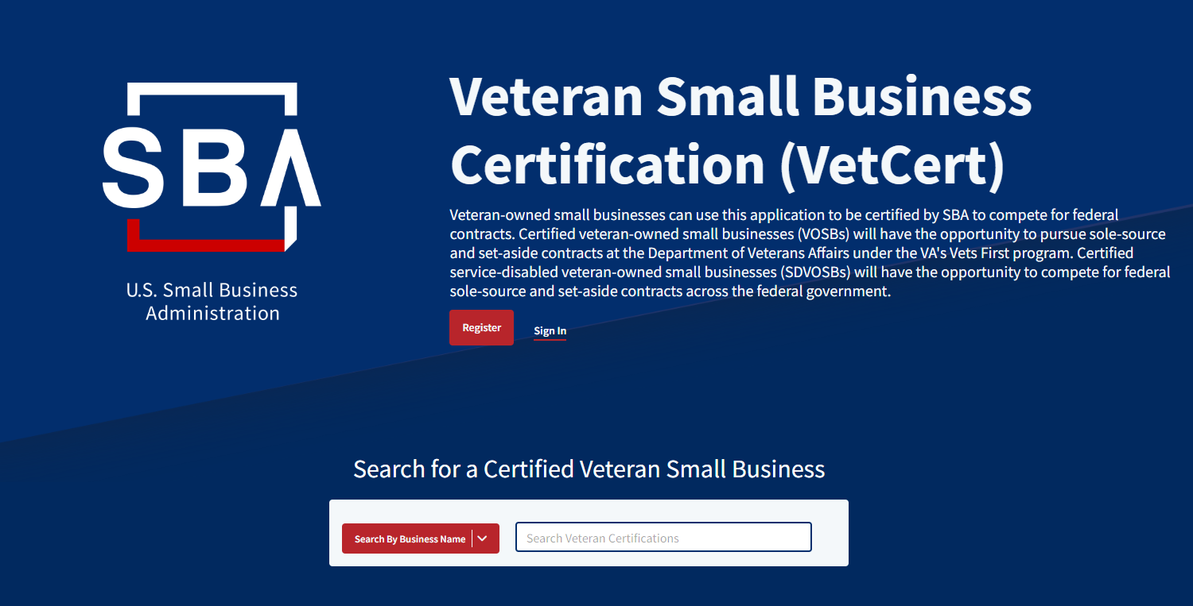
First Look: SBA's Veteran Small Business Certification Program
Landing Page to Login or Register a New Account
Veterans.certify.sba.gov
Notes:
You can also search for your business or others can search for certified businesses in the Search function

Slide 23
Is the Veteran Small Business Certification Program Related to the SBA’s MySBA Initiative?
The MySBA initiative is under development.
What is the vision for MySBA?
  Establishes a centralized/collaborative structure to understand, improve, and unite the customer experience across all SBA programs.
  Intended to provide a single point of access for SBA loans, certifications, counseling, trainings, etc.
  Customer experience is intended to be more customer-centric and easy to use.
  Streamlined processes will align data and customer engagement, reduce redundancies, etc.
Once MySBA is launched, the Veteran Small Business Certification Program will fall under its umbrella.

Slide 24
TIPS & MICHIGAN VETERAN RESOURCES
Make yourself stand out
“Tune-up OTHER TIPS” Maintain an updated Dynamic Small Business Search (DSBS) Profile
Look to become a General Services Administration (GSA) Schedule Holder
Apply for certification, if applicable, in as many socio-economic categories as you can

Slide 25

VetBizCentral
Mentoring Programs and Activities
Provide clients with Mentoring Assistance in Niche Markets and provide referrals to its other Resource Partners
Assist clients with Research in Specific Markets
Provide Market and Industry Professionals

Slide 26
VetBizCentral
Networking Opportunities
Workshops (Starting a Business, Government Contracting , Meet the Lender & more)
Symposiums (Empowering Women in Business in partnership with the Women’s Business Centers )
Annual Veterans Meet & Greet

Slide 27
VetBizCentral
Referral Services in
Michigan, Ohio & Indiana
SBA
APEX Accelerators
SCORE
Women Business Centers
Small Business Development Centers(SBDC)
Economic Development Centers
Community Development Financial Institutions (CDFI)
And More …

Slide 28
VetBizCentral
Abron Andrews, Jr.: VBOC Director at VetBizCentral
abron@vetbizcentral.org
810.767.8387
www.vetbizcentral.org
Mott Community College, Regional Technology Center
1401 E. Court St.
Flint, MI

Slide 29
For More Information
Visit
Visit SBA’s website: www.sba.gov/vetcert
Email
Email vetcert@sba.gov
Contact
Contact the dedicated toll-free call center: 800-862-8088
Monday -Friday, 8 a.m. – 6 p.m. ET
Visit
Visit the Frequently Asked Questions on the VetCert platform
Veterans.certify.sba.gov

Slide 30





Stay Connected
SBA Links & Contacts
Subscribe to SBA’s e-newsletter: www.sba.gov/updates
Follow the SBA on Twitter: @ Michigan_do
Email: gabrielle.coner@sba.gov
Call: (313) 324-3604
www.sba.gov/district/michigan
www.sba.gov/

Slide 31

Gabrielle Coner
Business Opportunity Specialist
(313) 324-3604 | gabrielle.coner@sba.gov

Slide 32
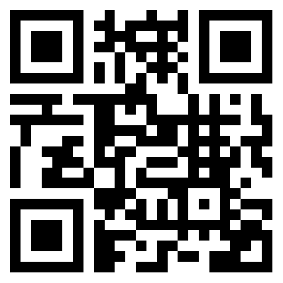
How are we doing?
Please take a minute to let us know
www.sba.gov/feedback

